Slide 1


Letzte Seite nicht vergessen
Introduction to Statistics
Dr. Harald Stein
LinkedIn: https://www.linkedin.com/in/harald-stein-phd-1648b51a
ResearchGate: https://www.researchgate.net/profile/Harald-Stein

Slide 2
Introduction to Statistics
Introduction to Statistics
Agenda Apr 16 2024
Technical Prerequisites
Descriptive statistics
Combinatorics
Distributions
Conditional probability
Sampling
Hypothesis testing
Model estimation
09:30 – 10:00 Technical readiness, Introduction
10:05 – 11:30 Descriptive statistics, Combinatorics
11:35 – 13:00 Distributions, Conditional probability
13:00 – 13:30 Break
13:30 – 15:30 Sampling, Hypothesis testing
15:35 – 17:00 Modell estimation
17:05 – 17:30 Buffer: Exercises & Discussion
Let‘s start
2

Slide 3
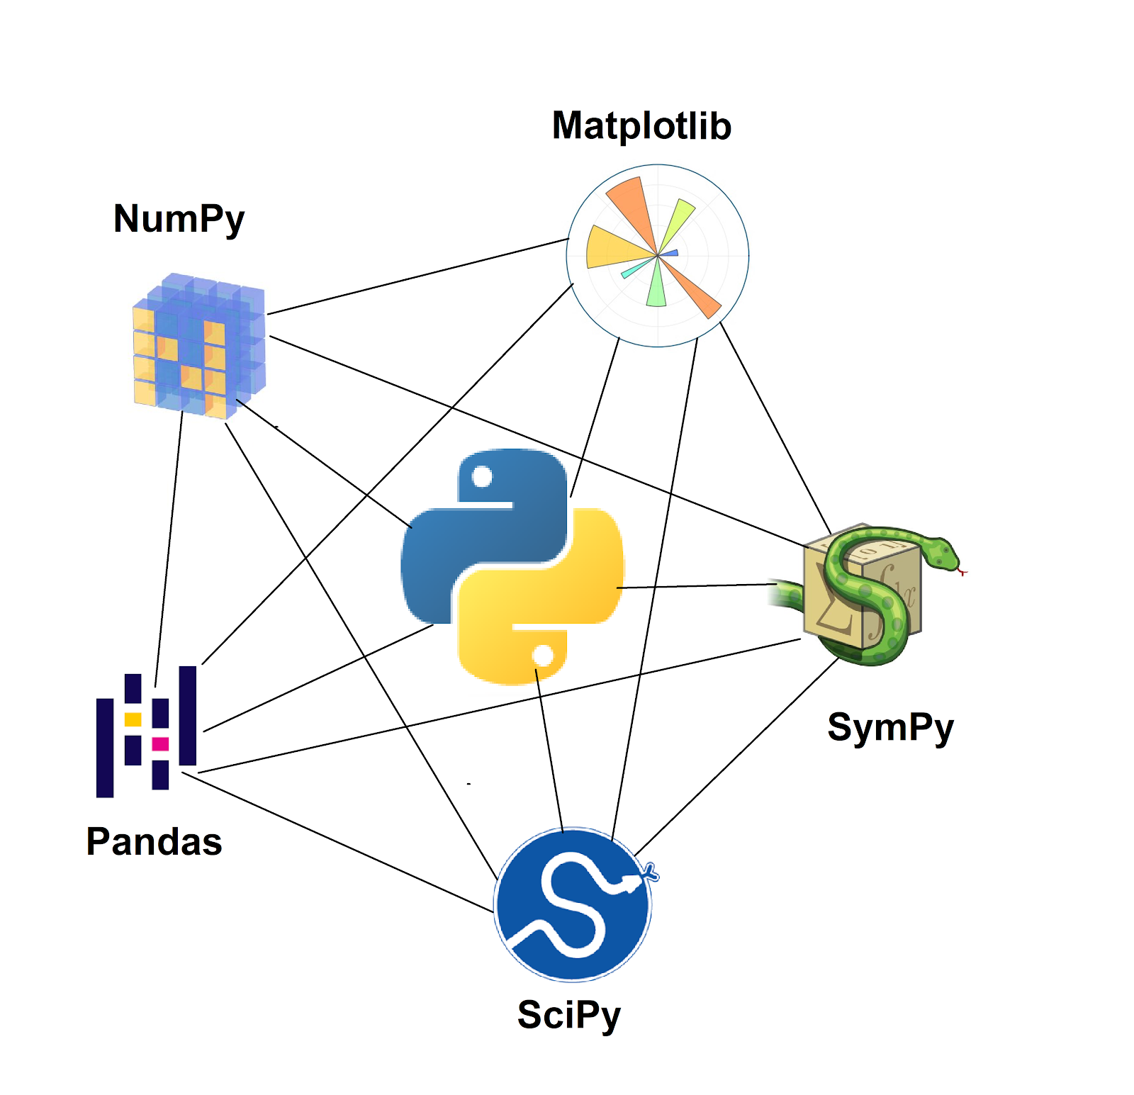



1. Technical Prerequisites
means installation of Python environment with Jupyter
Install the environment:
GitHub Link: https://github.com/MathforDataScience/DSR_Statistics1/
List of packages: requirements.txt
How to install: readme.txt
Start Jupyter Notebook
3

Slide 4
2. Descriptive statistics
involves the organization, summarization, and visualization of data. It provides simple summaries about the sample and the measures.
Types of Data
Measures: central tendency, dispersion
Measures: Skewness and kurtosis
Quantiles
Graphical representation of data
Exercises
4

Slide 5
Types of Data
Definition and examples of Qualitative and Quantitative data
Type of Data | Subtype of data | Example
Quantitative / Numerical: can be measured or counted | Discrete: can only take certain values | number of students in a class
 | Continuous: can take any value within certain range | Age, Height, Weight, Temperature, Income
 | Interval | Temperature IQ scores Years
 | Ratio | Probability
Qualitative / Categorical: non-numerical often relates to subjective qualities, characteristics, or descriptions | Nominal: No order, hierarchy or sequence | Colors Types of cuisine Genders Blood types
 | Ordinal: can be arranged in a particular order | Survey responses Educational level Military rank
... other types of data: binary, time-series, geodata, textual, multimedia, etc.

Slide 6
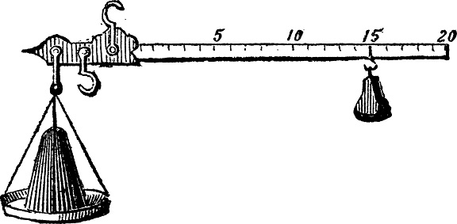
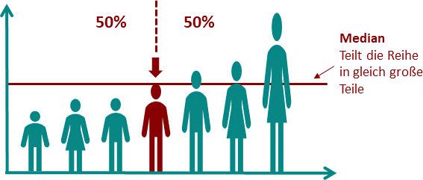
Measures of Central Tendency
calculate typical central points that describe or represent dataset
Arithmeric Mean
Sum of all data points divided by number of data points
E.g.: (1+2+3)/3 = 2
Median
middle value in an ordered dataset
E.g.: For {1, 2, 3}, the median is 2
Interesting because of outlier resistance!
... Other measures of centrality:
Geometric mean: e.g. population growth, investment return
Harmonic mean: e.g. F-score (Machine Learning, binary classification, evaluation of results)

Slide 7
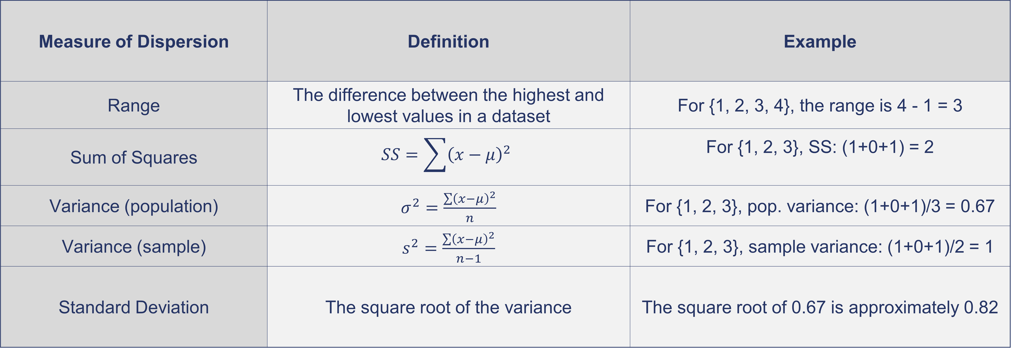
Measures of Dispersion
provide information about how data values are distributed around central tendency
Measure of Dispersion | Definition | Example
Range | The difference between the highest and lowest values in a dataset | For {1, 2, 3, 4}, the range is 4 - 1 = 3
Sum of Squares | $$SS=\sum{{\left(x−μ\right)}^{2}}$$ | For {1, 2, 3}, SS: (1+0+1) = 2
Variance (population) | $σ^{2}=\frac{\sum{{\left(x−μ\right)}^{2}}}{n}$ | For {1, 2, 3}, pop. variance: (1+0+1)/3 = 0.67
Variance (sample) | $s^{2}=\frac{\sum{{\left(x−μ\right)}^{2}}}{n−1}$ | For {1, 2, 3}, sample variance: (1+0+1)/2 = 1
Standard Deviation | The square root of the variance | The square root of 0.67 is approximately 0.82

Slide 8
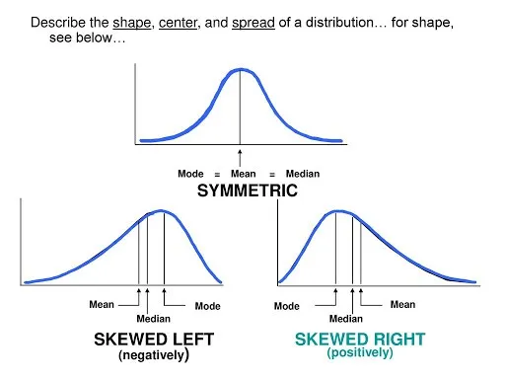
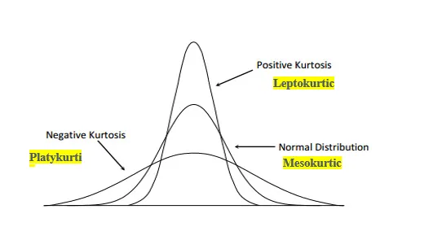
Skewness and Kurtosis
Describe asymmetry of distributions diviation from normal distribution
Skew
Measure of asymmetry of the probability distribution
of a real-valued random variable about its mean
Positive (negative): Long tail on the right (left)
Kurtosis
defines how heavily the tails of a distribution differ from the tails of a normal distribution
Outliers may facilitate positive kurtosis

Slide 9
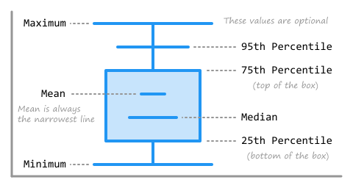
Quantiles
statistical measures that divide a dataset into intervals of equal probability
Quantiles …
are used to understand data distribution and identify outliers
partition data into several subsets containing equal number of observations.
Several types of quantiles:
Quartiles: divide the data into four equal parts.
Deciles: These divide the data into ten equal parts.
Percentiles: These divide the data into 100 equal parts.
Median: separates data into two halves, with 50% of the data falling below and 50% above the median.
Possibly outlier

Slide 10
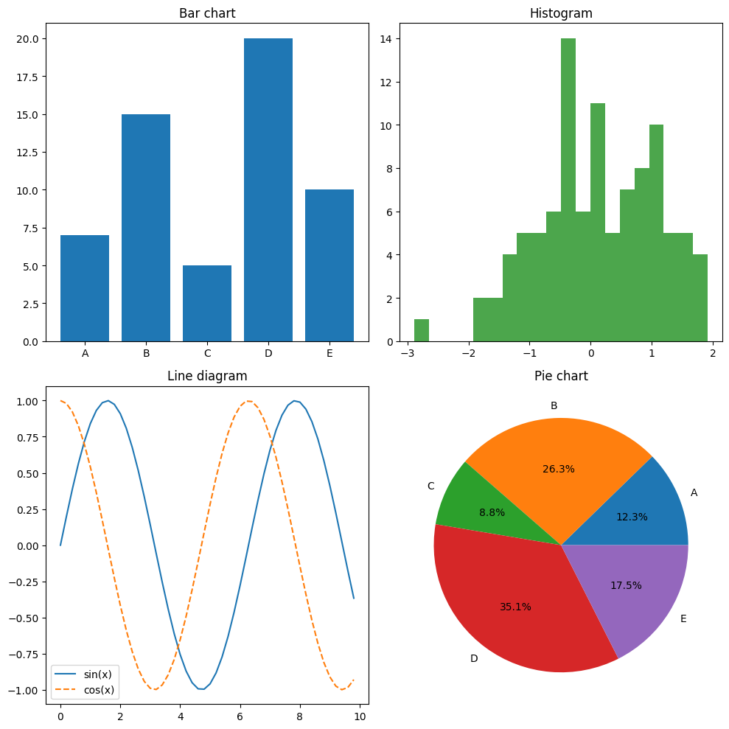
Graphical Representation of Data
Input:
Categorical
Nominal
unordered
Output:
Numerical
Continuous
Absolute
Input:
Categorical
Nominal
ordered
Output:
Numerical
Continuous
Absolute
Input:
Categorical
Nominal
Unordered or ordered
Output:
Numerical
Continuous
relative
Input:
Numerical
continuous
Output:
Numerical
continuous

Slide 11
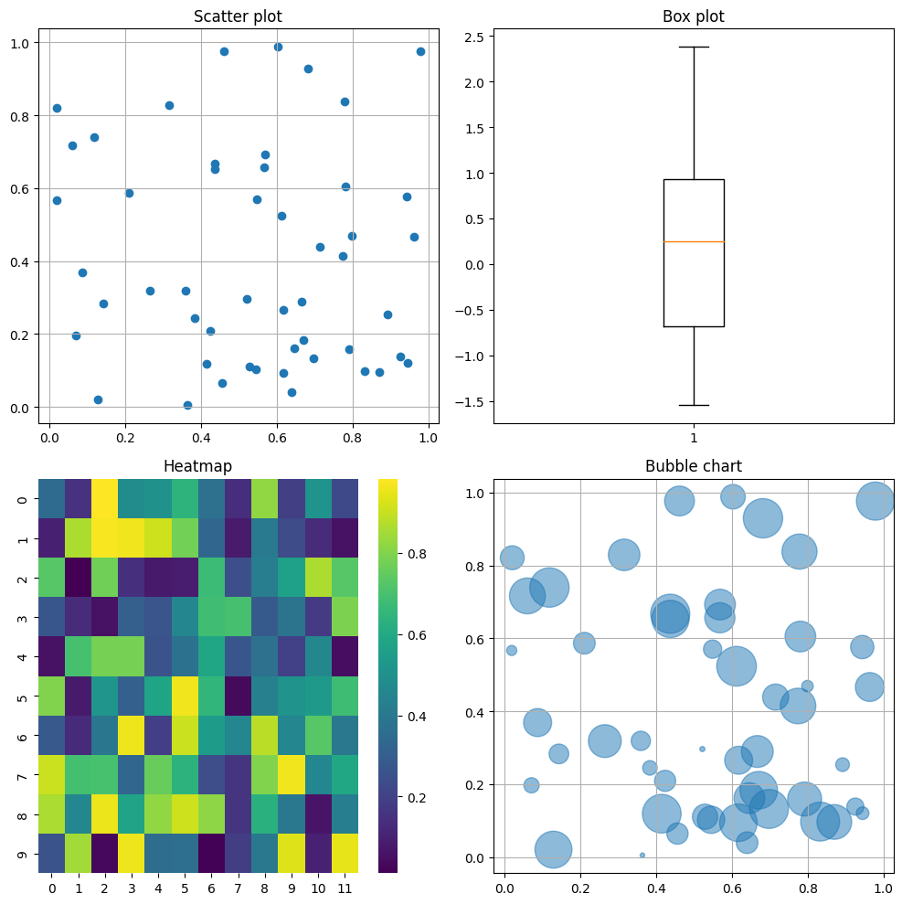
Graphical Representation of Data
Input:
2 Features
Both numerical
Output:
Boolean (1;0)
Input:
1 feature
numerical
Output:
At least ordered
Or numerical
Input:
2 Features
Both categorical
Output:
Numerical
Input (like scatter plot):
2 Features
Both numerical
Output:
Numerical

Slide 12
Exercises
Exercise 1:
Question: Given the array numbers = np.array([1, 2, 3, 4, 5, 6, 7, 8, 9, 10]), compute the mean of the numbers.
Exercise 2:
Question: Given the array numbers from Exercise 1, compute the median of the numbers.
Exercise 3:
Question: Compute the variance of the numbers.
a) Use population variance b) Use sample variance
ages = [21, 23, 25, 27, 29, 31, 33]
b) Let's say we take a sample of 5 ages from the original group: sample_ages = [21, 23, 27, 31, 33]
Exercise 4:
Question: Given the array numbers from Exercise 1, compute the standard deviation of the numbers.
Exercise 5:
Question: Given the array numbers from Exercise 1, compute the first quartile (25th percentile), the second quartile (50th percentile, or median), and the third quartile (75th percentile) of the numbers.
Exercise 6:
show with python plots in a 2x2 subfigure matrix for …
bar chart, histogram, line diagram, pie diagram
Scatter plot, Box plot (Box-and-whisker plot), Heatmap, bubble chart

Slide 13
3. Combinatorics
is concerned with the study of countable, discrete structures and includes the arrangement, combination, and permutation of sets.
Permutation
k-permutation
Combination
Pascal‘s triangle
Exercises
13

Slide 14
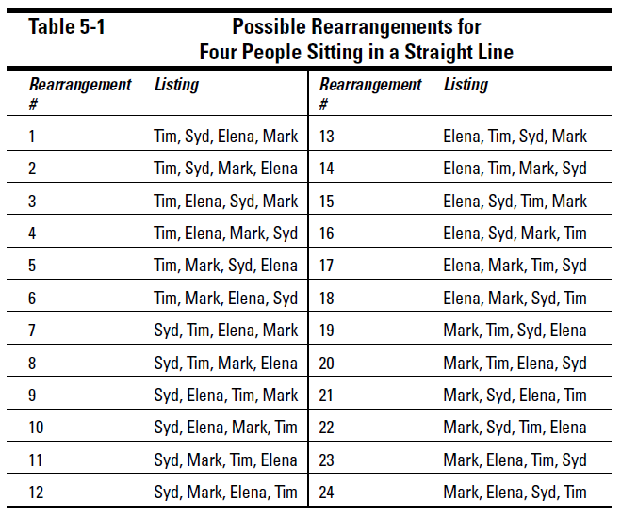
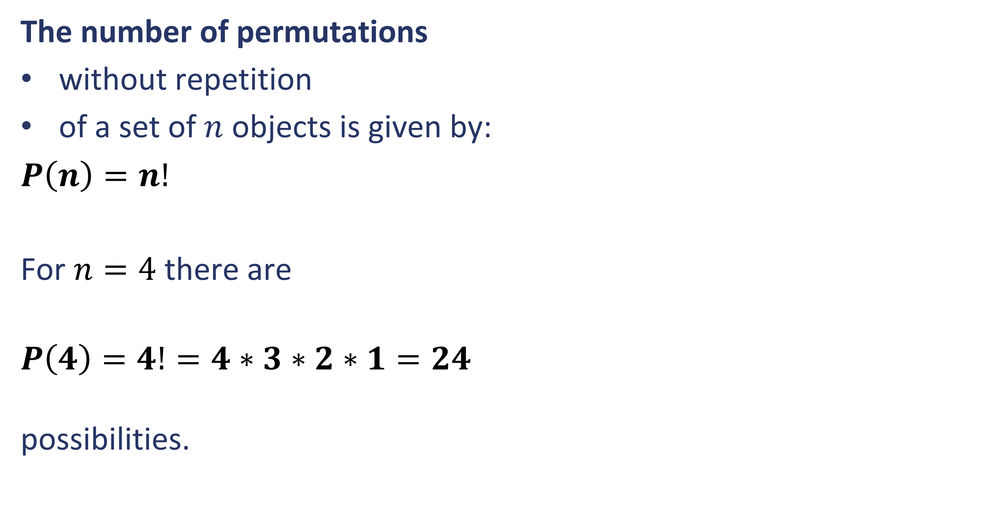
Permutation
is an arrangement of objects in a specific order.
The number of permutations
without repetition
of a set of $n$ objects is given by:
$P\left(n\right)=n!$
For $n=4$ there are
$P\left(4\right)=4!=4∗3∗2∗1=24$
possibilities.

Slide 15
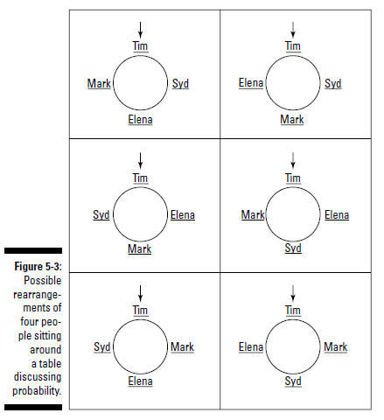
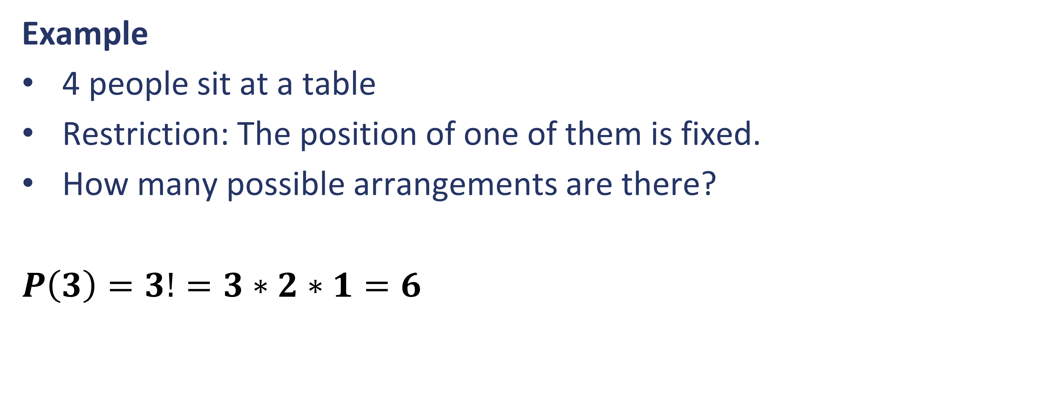
Permutation
is an arrangement of objects in a specific order.
Example
4 people sit at a table
Restriction: The position of one of them is fixed.
How many possible arrangements are there?
$P\left(3\right)=3!=3∗2∗1=6$

Slide 16
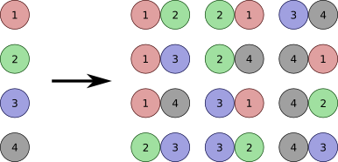
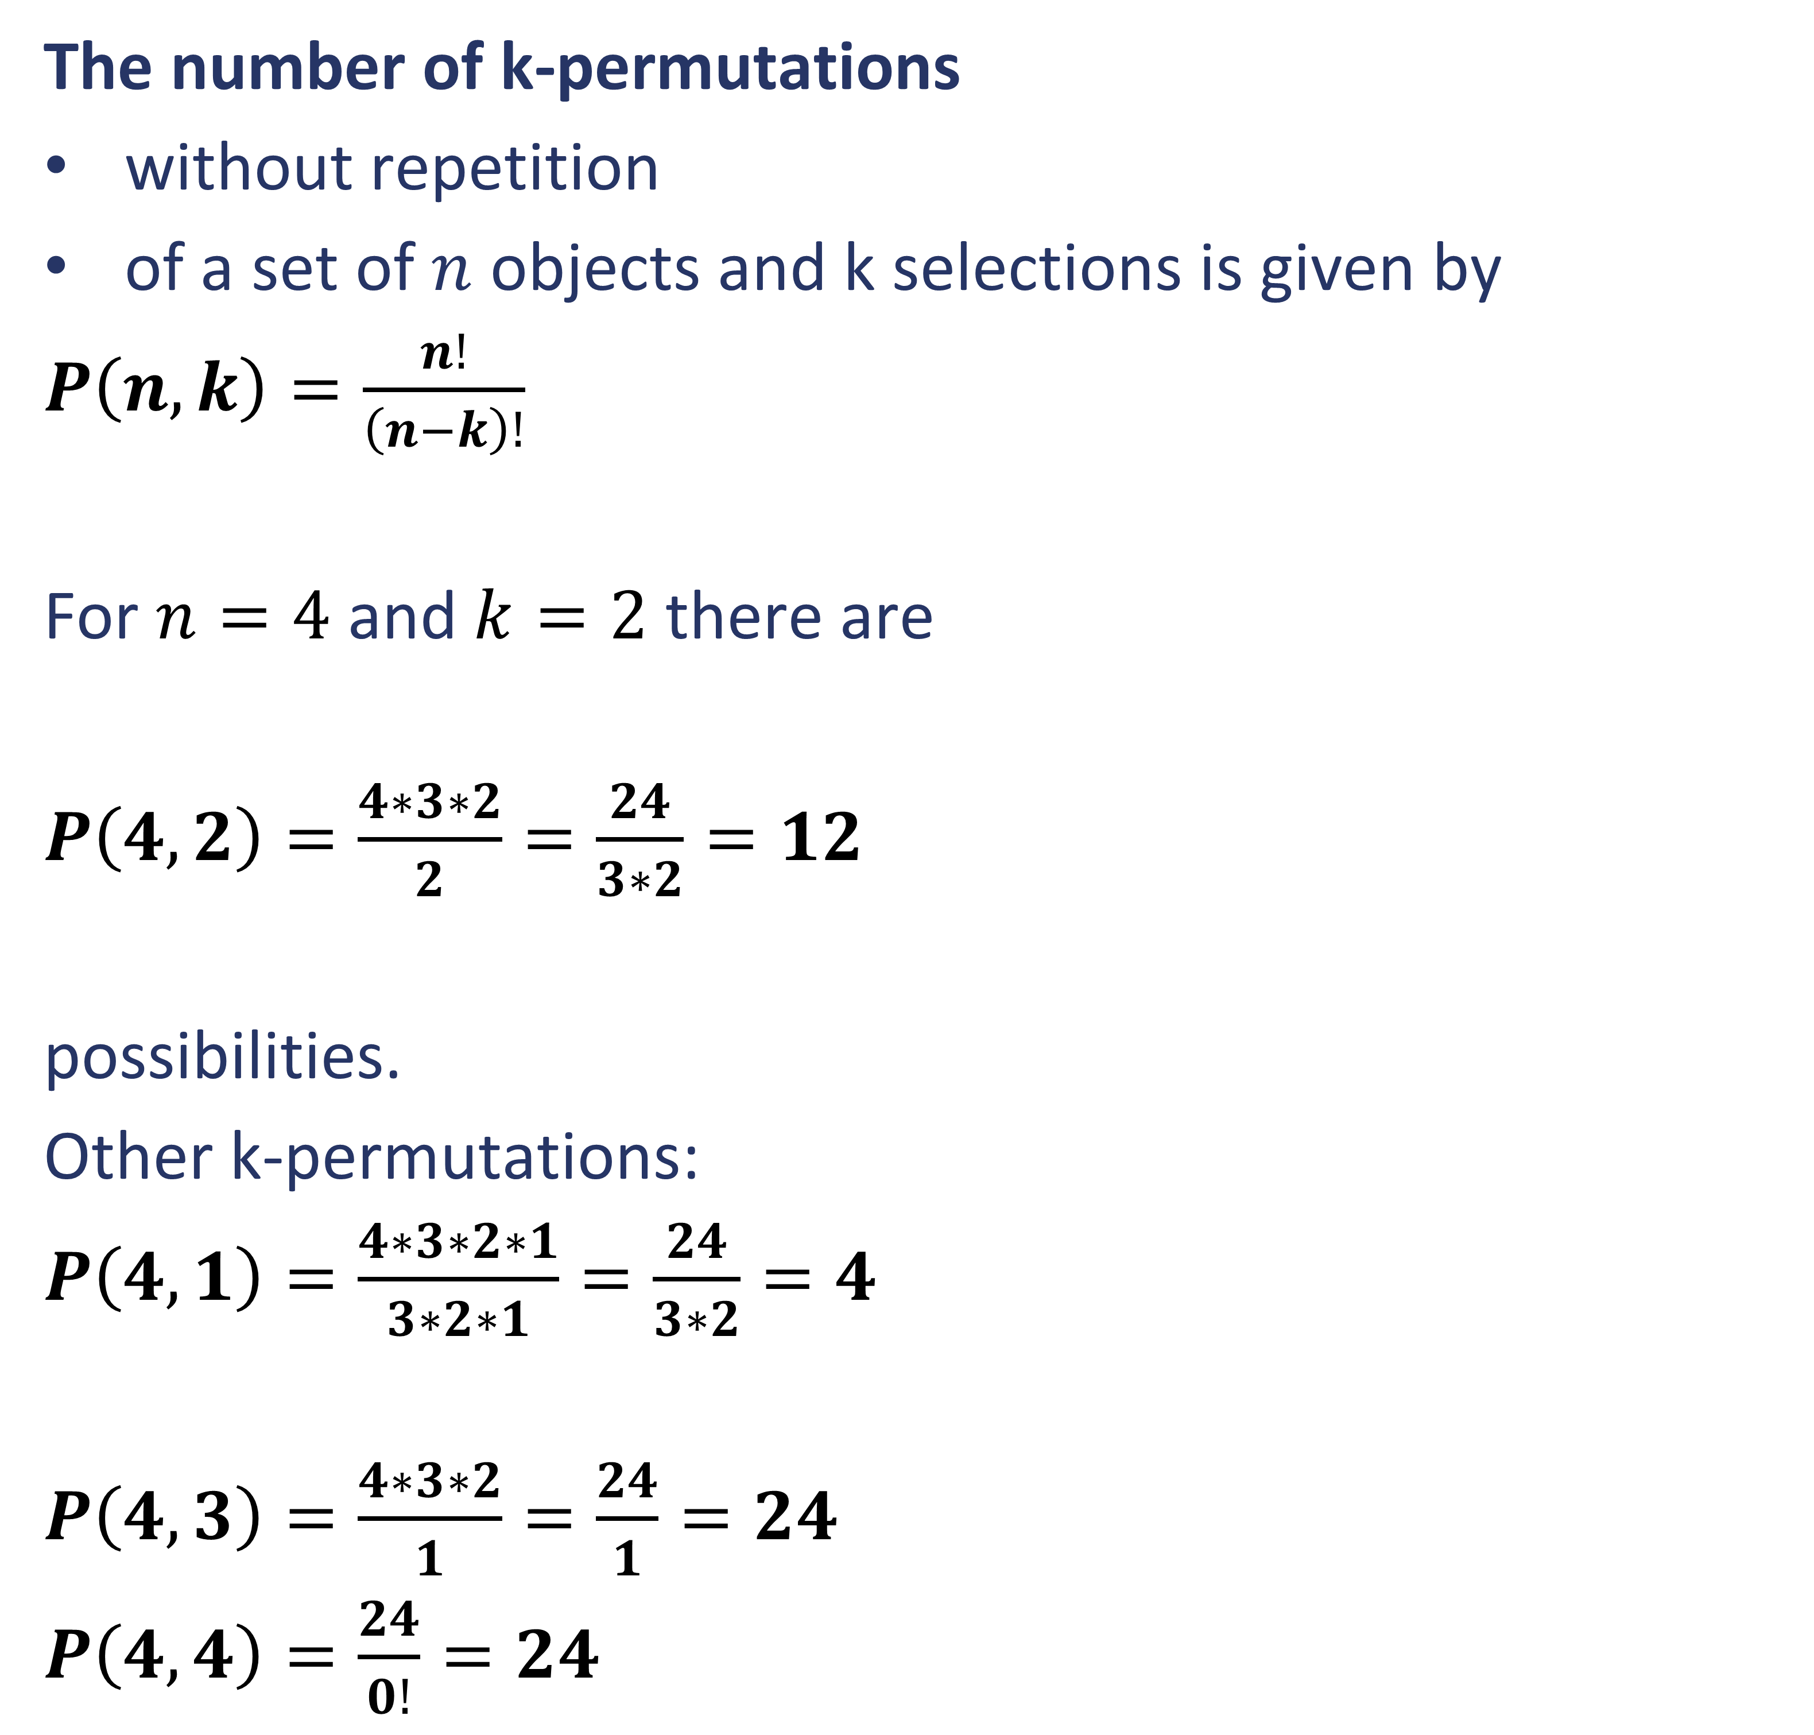
K-permutation
is an ordered arrangement of k elements selected from that set. In German it is called “Variation”
The number of k-permutations
without repetition
of a set of $n$ objects and k selections is given by
$P\left(n,k\right)=\frac{n!}{\left(n−k\right)!}$
For $n=4$ and $k=2$ there are
$P\left(4,2\right)=\frac{4∗3∗2}{2}=\frac{24}{3∗2}=12$
possibilities.
Other k-permutations:
$P\left(4,1\right)=\frac{4∗3∗2∗1}{3∗2∗1}=\frac{24}{3∗2}=4$
$P\left(4,3\right)=\frac{4∗3∗2}{1}=\frac{24}{1}=24$
$P\left(4,4\right)=\frac{24}{0!}=24$
File:Kpermutation.png - Wikimedia Commons

Slide 17

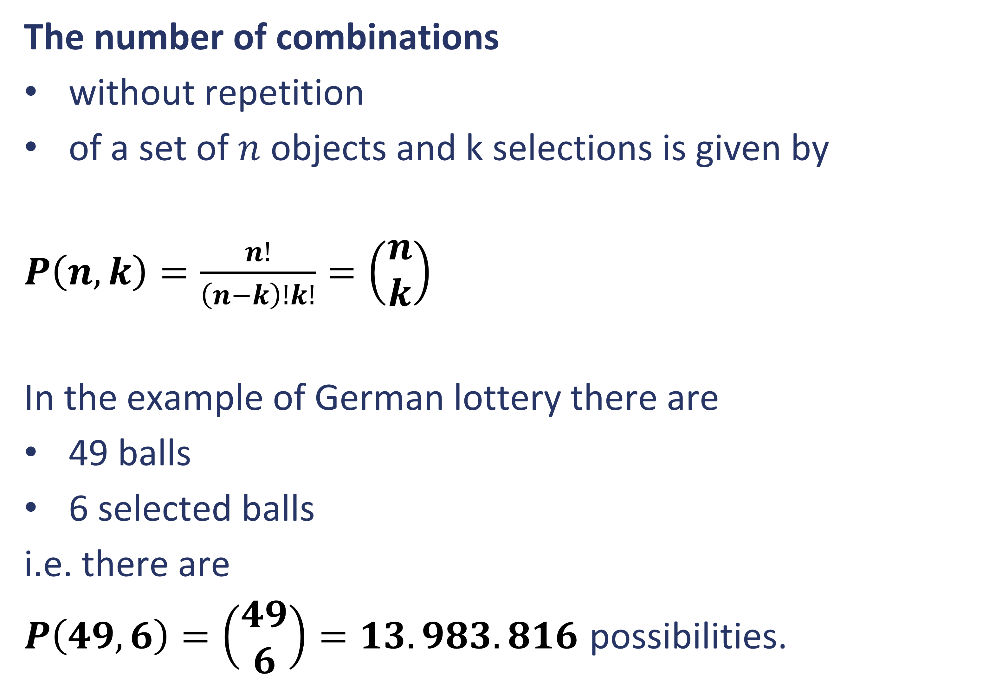
Combination
is a selection of items from a larger set where the order of selection does not matter.
The number of combinations
without repetition
of a set of $n$ objects and k selections is given by
$P\left(n,k\right)=\frac{n!}{\left(n−k\right)!k!}=\left(\begin{matrix}n \\ k\end{matrix}\right)$
In the example of German lottery there are
49 balls
6 selected balls
i.e. there are
$P\left(49,6\right)=\left(\begin{matrix}49 \\ 6\end{matrix}\right)=13.983.816$ possibilities.

Slide 18
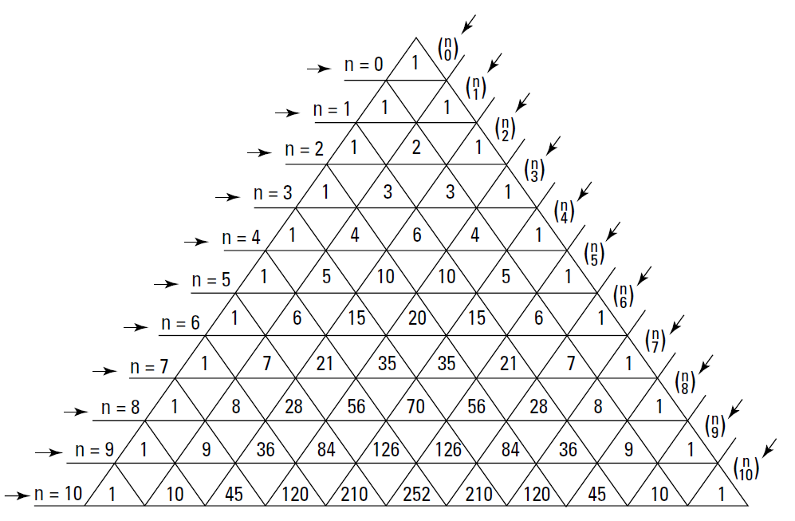
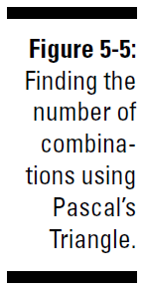
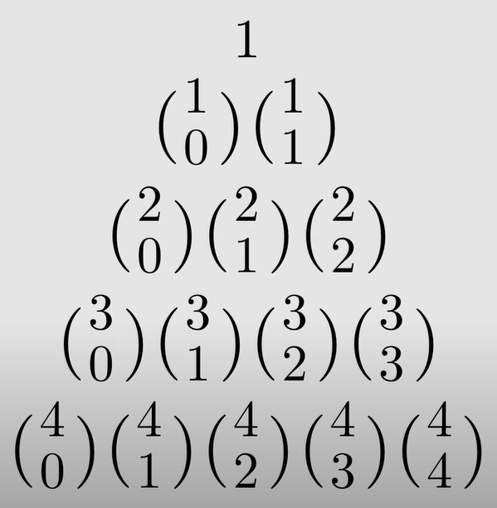
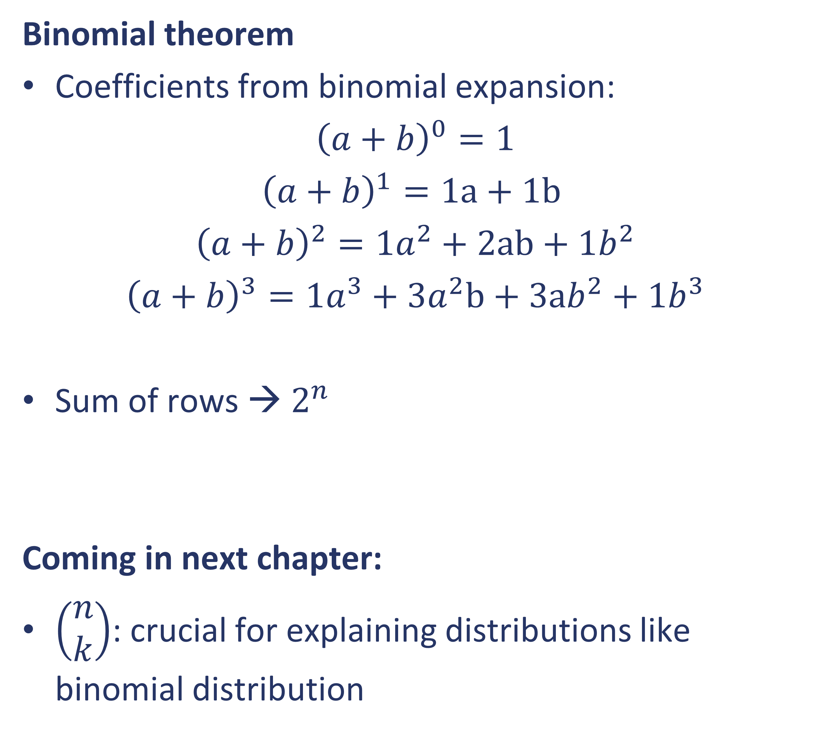
Pascal‘s triangle
is a triangular array of numbers in which each number is the sum of the two directly above it. It is used for binomial expansions, combinatorics, probability calculations, etc.
Binomial theorem
Coefficients from binomial expansion:
$${\left(a+b\right)}^{0}=1$$
$${\left(a+b\right)}^{1}=1a+1b$$
$${\left(a+b\right)}^{2}=1a^{2}+2ab+1b^{2}$$
$${\left(a+b\right)}^{3}=1a^{3}+3a^{2}b+3ab^{2}+1b^{3}$$
Sum of rows → $2^{n}$
Coming in next chapter:
$\left(\begin{matrix}n \\ k\end{matrix}\right)$: crucial for explaining distributions like binomial distribution

Slide 19
Exercises
Exercise 1: Count the permutations
Write a function that returns the number of all possible permutations of a list.
def count_permutations(lst): # Your code here
print(count_permutations(['A', 'B', 'C']))
Additionally: Try also lists with other lengths
Exercise 2: Generate all permutations of a list: l1 = ['A', 'B', 'C']
Exercise 3: Count the k-permutations
Write a function that returns the number of all possible k-permutations of a list.
Exercise 4: Generate k-permutations of a list
In this exercise, your task is to write a function that generates all possible k-permutations of a given list using itertools.
Exercise 5: Generate all combinations of size k
Write a function that generates all possible combinations of size k from a given list of size n=8. ['apple','banana','pear','grapes','orange','mango','blueberry','strawberry']
Exercise 6: Calcucate the number of combinations
n = 8 k = 2

Slide 20
4. Distributions
describe the probabilities of occurrences of different possible outcomes in an experiment
Overview of important distributions
Way to… binomial distribution
Poisson distribution
Normal distribution, standard normal distribution
Students‘ t-distribution
$χ^{2}$- distribution
F-Distribution
Exercises
20

Slide 21
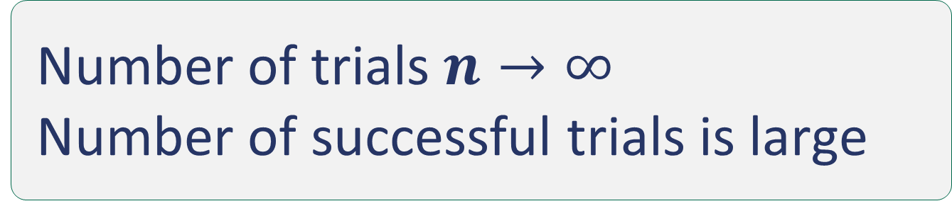
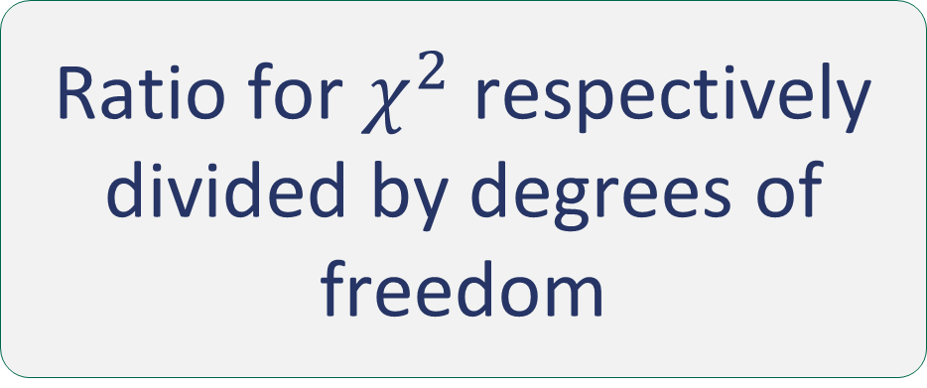
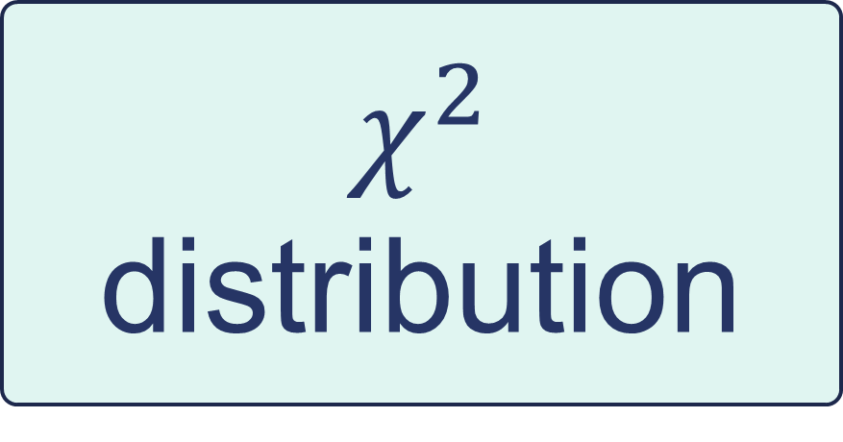
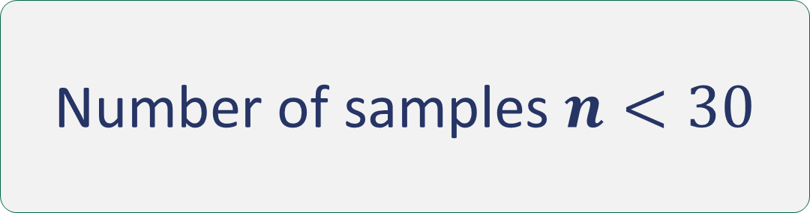

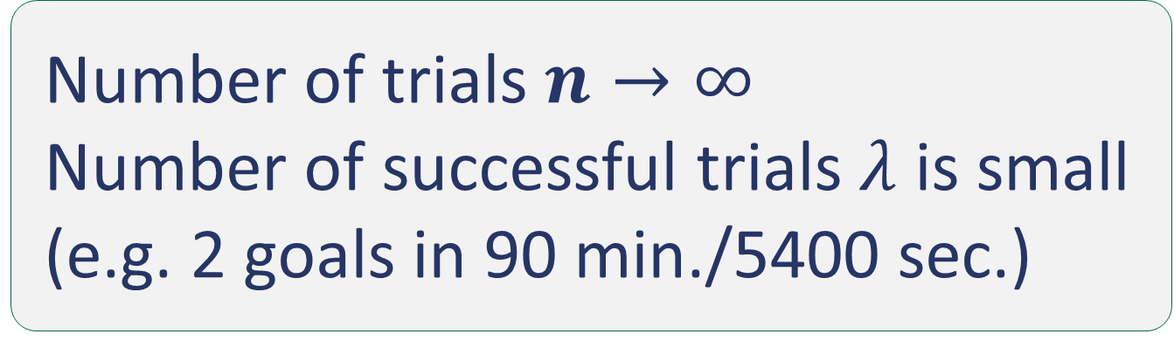
Overview of important distributions
Most common distributions are based on the binomial distribution.
Fair coin toss
Uniform
Number of trials $n→∞$
Number of successful trials is large
Normal distribution - population mean divided by population std. dev.
Sum of squared Standard normal distributions
Ratio for $χ^{2}$ respectively divided by degrees of freedom
Repeated Bernoulli
Bernoulli
Binomial distribution
Normal distribution
Standard normal distribution
$$χ^{2}$$
distribution
F
distribution
Coin toss with non-uniform probability
$λ$becomes large
Number of samples $n<30$
Poisson distribution
Student‘s t-distribution
Number of trials $n→∞$
Number of successful trials $λ$ is small (e.g. 2 goals in 90 min./5400 sec.)
21

Slide 22

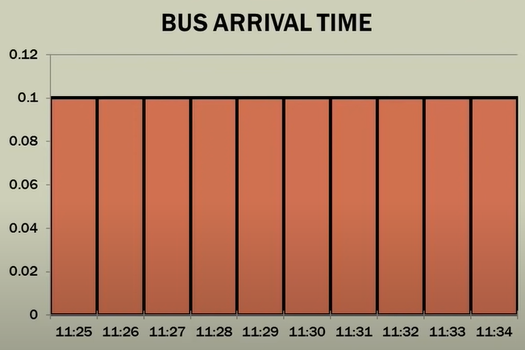
Uniform distribution
is a probability distribution that describes the number of successes in a fixed number of independent binary experiments, each with the same probability of success.
Expected value:
Arithmetic mean
Use Cases:
Generating Random Numbers: e.g.: fair dice, fair coin tosses
Quality Control and Manufacturing: e.g.: check the uniformity of products
Be careful:
Sum of 2 dice is not uniformly distributed! (it is multinomial distribution, out of scope)

Slide 23
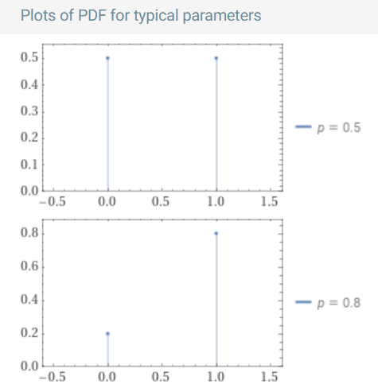
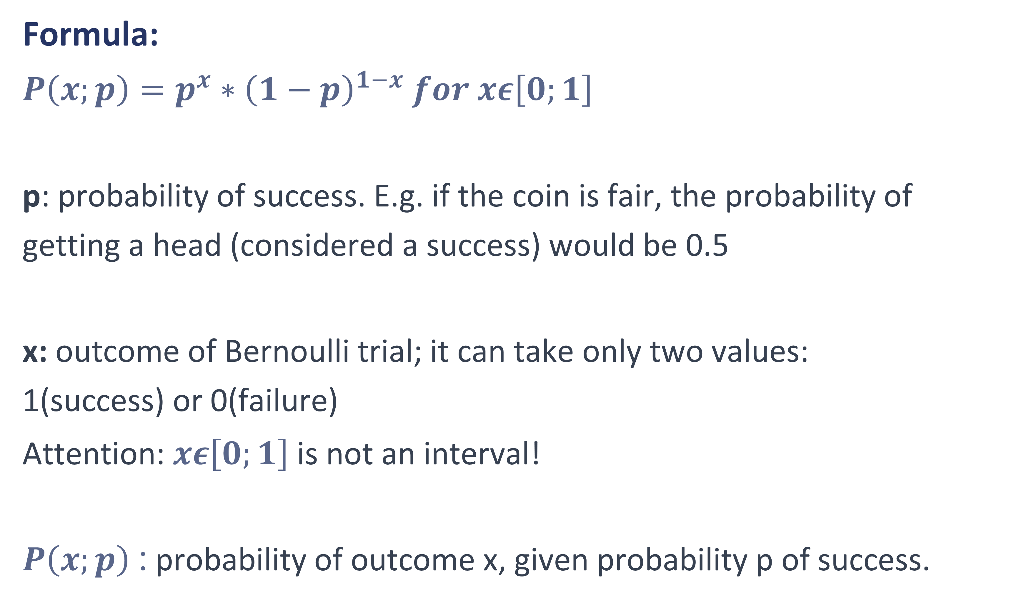
Bernoulli distribution
is a discrete probability distribution for a random variable which can take a binary outcome: one (success) or zero (failure); example: toss of coin (that is not necessarily fair)
Formula:
$P\left(x;p\right)=p^{x}∗{\left(1−p\right)}^{1−x} for xε\left[0;1\right]$
p: probability of success. E.g. if the coin is fair, the probability of getting a head (considered a success) would be 0.5
x: outcome of Bernoulli trial; it can take only two values: 1(success) or 0(failure)
Attention: $xε\left[0;1\right]$ is not an interval!
$P\left(x;p\right)$ : probability of outcome x, given probability p of success.

Slide 24
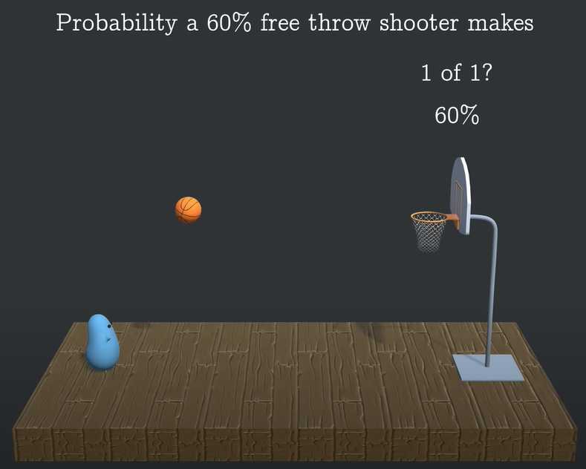
Binomial distribution
Example for probability calculation: Basketball player that is known for 60% prob of making free shots makes 7 of 10
Step 1:
P(Make the shot) = 60 %
P(Miss the shot) = 40 %
= 1 – 60 %

Slide 25
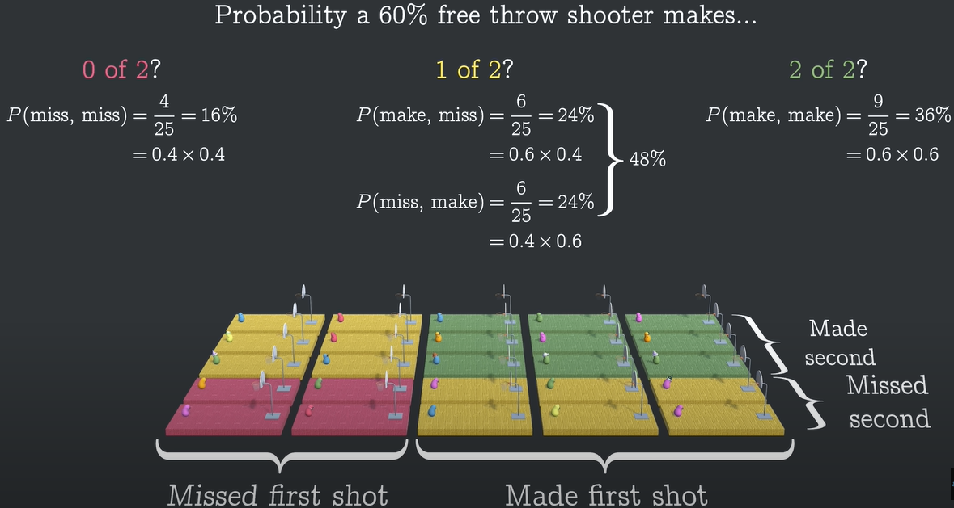
Binomial distribution
Example for probability calculation: Basketball player that is known for 60% prob of making free shots makes 7 of 10; Step 2
Step 2:
P(miss, miss) = 16 %
P(miss, make) = 48 %
P(make, make) = 36 %
Assumption:
Independence of shots

Slide 26
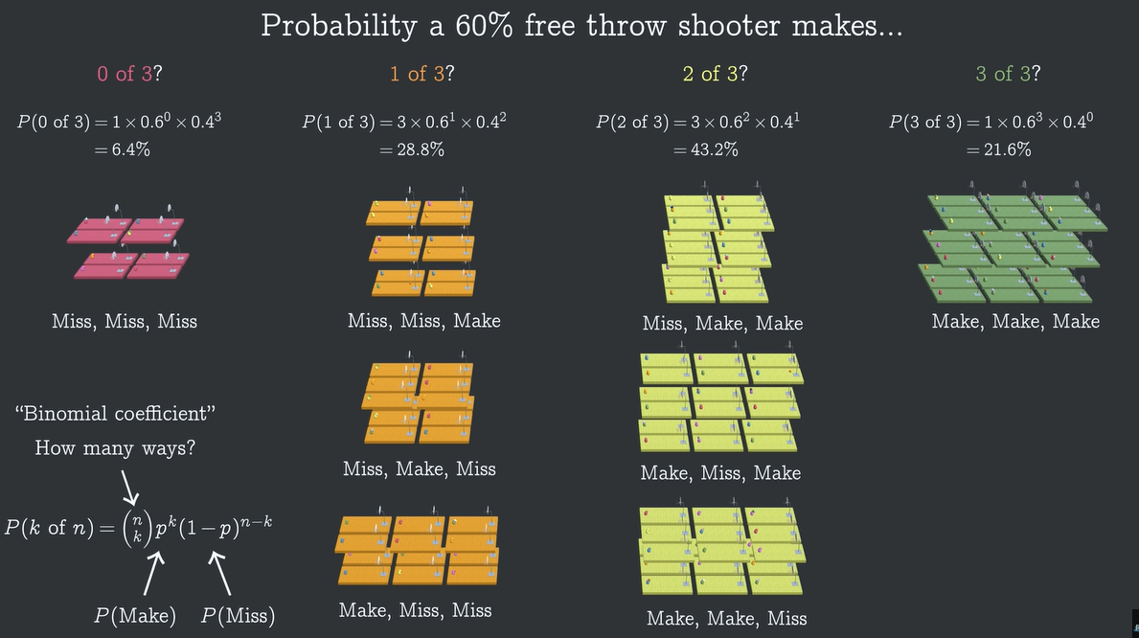
Binomial distribution
Example for probability calculation: Basketball player that is known for 60% prob of making free shots makes 7 of 10; Step 3
Step 3:
P(miss, miss, miss) = 8 %
P(miss, miss, make) = 28.8 %
P(miss, make, make) = 43.2 %
P(make, make, make) = 21.6 %

Slide 27
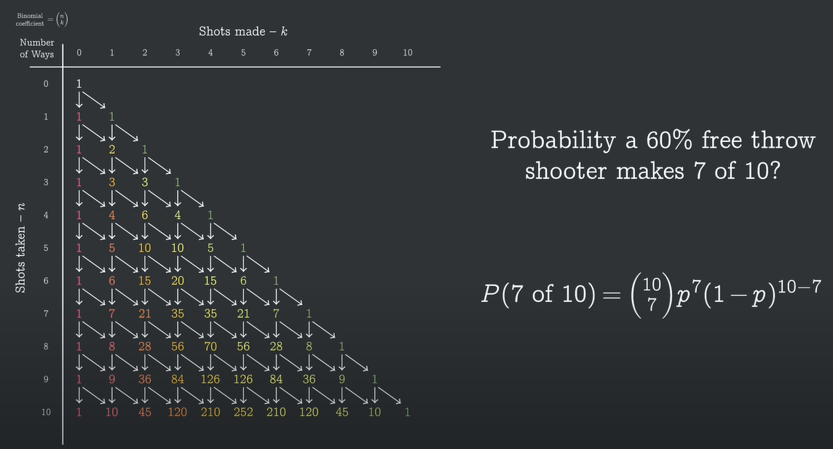
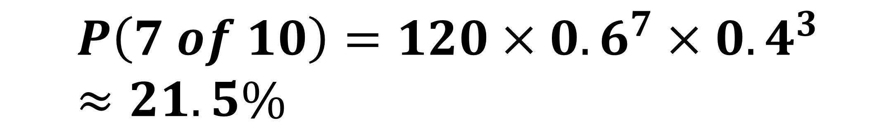
Binomial distribution
Example for probability calculation: Basketball player that is known for 60% prob of making free shots makes 7 of 10; Step 4
$$P\left(7 of 10\right)=120×{0.6}^{7}×{0.4}^{3}≈21.5\%$$

Slide 28
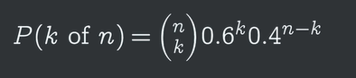
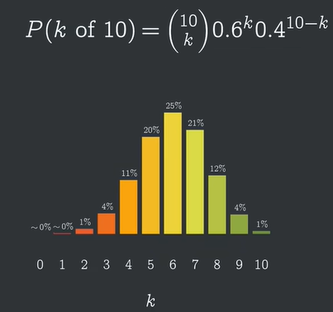
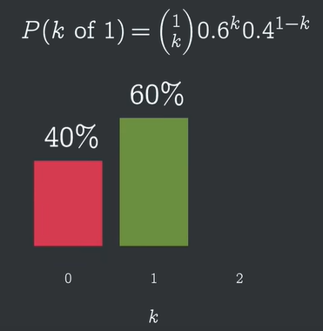
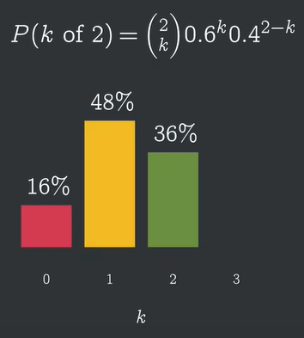
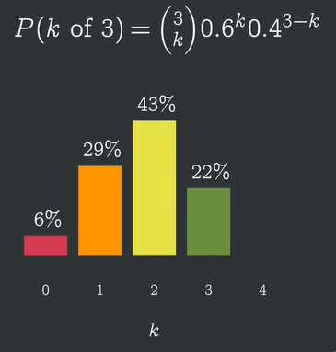
Binomial distribution
Example for probability calculation - Generalization: Basketball player that is known for 60% prob of making free shots makes k of n
This example

Slide 29
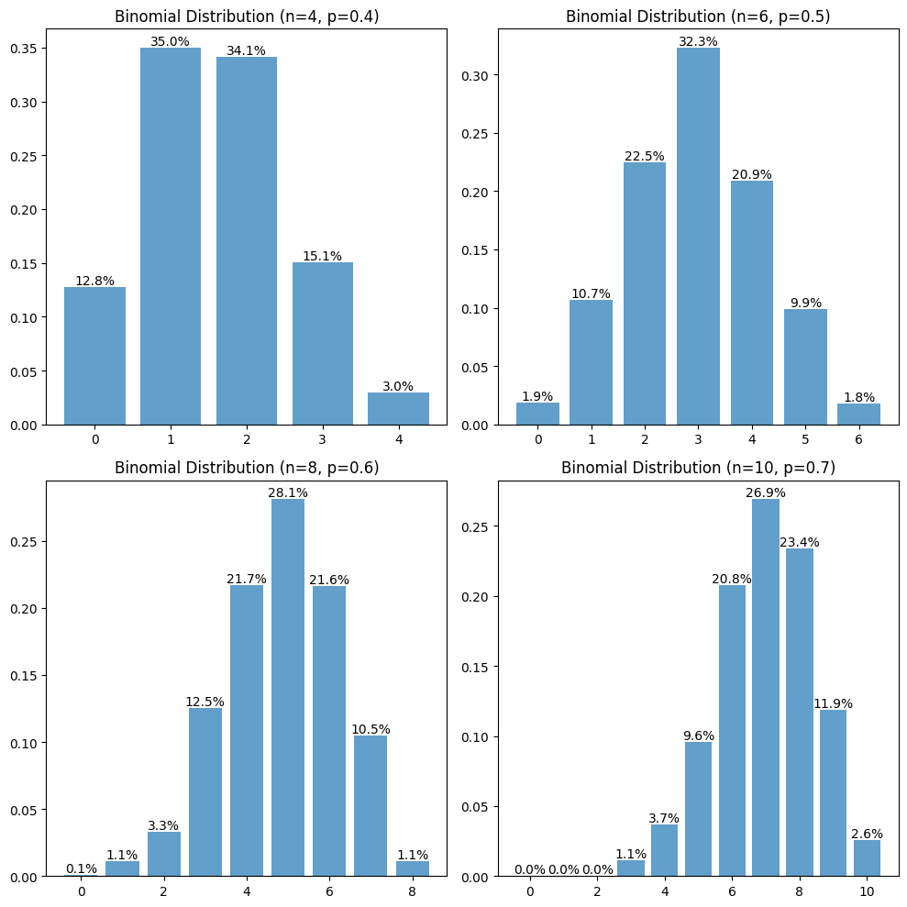
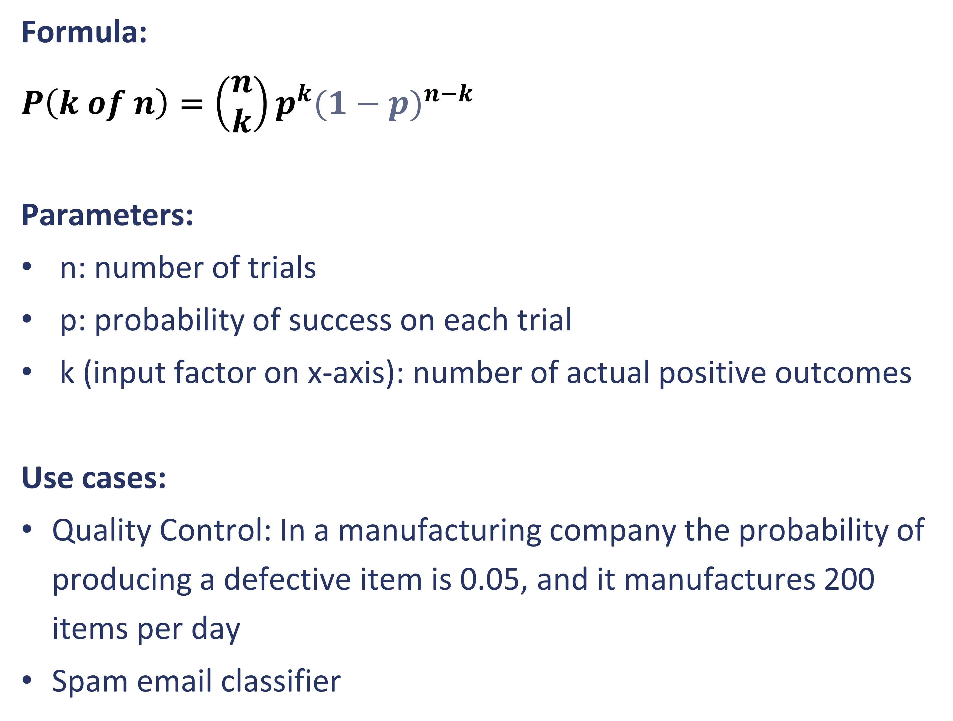
Binomial distribution
is repeated Bernoulli distribution, i.e. probability distribution that describes number of successes in fixed number of independent binary experiments, each with same probability of success.
Formula:
$P\left(k of n\right)=\left(\begin{matrix}n \\ k\end{matrix}\right)p^{k}{(1−p)}^{n−k}$
Parameters:
n: number of trials
p: probability of success on each trial
k (input factor on x-axis): number of actual positive outcomes
Use cases:
Quality Control: In a manufacturing company the probability of producing a defective item is 0.05, and it manufactures 200 items per day
Spam email classifier

Slide 30
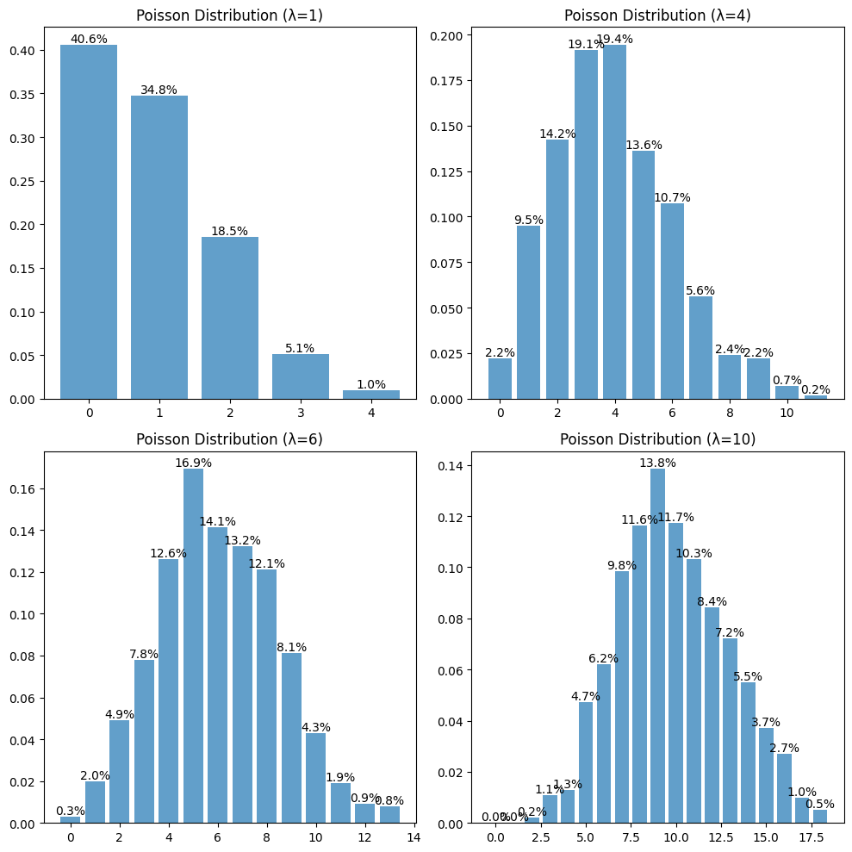
Poisson distribution
probability distribution of a given number of independent events occurring in a fixed interval of time or space, given fixed average rate of occurrence.
Events occur with a known constant mean rate and independently of the time since the last event.
Relation to binomial distribution:
The number of trials (n) is very large, i.e. continuous.
The probability of success (p) is small.
The average number of successes (np) is moderate.
Parameter:
λ = np (the mean of the distribution)
Use cases:
Number of calls received in a given hour, sales per hour, etc.
emails arriving in inbox per hour, given average arrival rate
Very few defect items per hour
AI use cases:
Sport bets: goals/baskets per match (Prediction of football, basketball results)

Slide 31
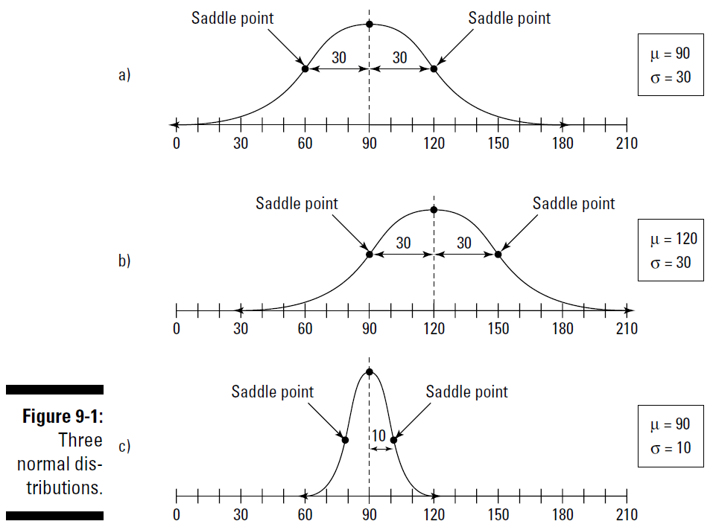
Normal distribution
is a continuous probability distribution characterized by a symmetric bell-shaped curve, defined by its mean (average) and standard deviation, also known as the Gaussian distribution
Parameters:
Mean: where the peak of the bell occurs
Standard deviation: determines the width of the bell
Use cases:
Human Heights: most individuals have heights around the average, very tall or small people are much less frequent
Test Scores: most students will score around average, fewer students have very high/low scores.

Slide 32
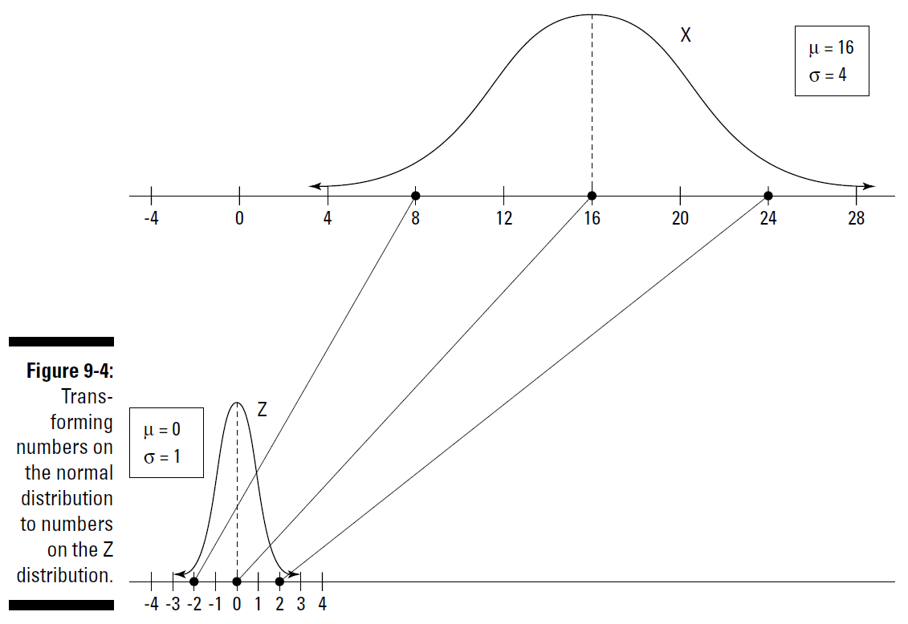
Standard normal distribution
is a special case of the normal distribution with a mean of zero and standard deviation of one.
z-scoring" or standardization
subtracting the mean score
and dividing by the standard deviation
Properties:
mean (μ): 0
standard deviation (σ): 1
symmetric, bell-shaped
Why is it useful?
This makes it easier to compare scores from different tests or datasets.
AI use case:
Supervised learning: Prediction errors (differences between actual and predicted values) are often standard normally distributed, e.g. a house price predictor based area, number of rooms, etc.

Slide 33
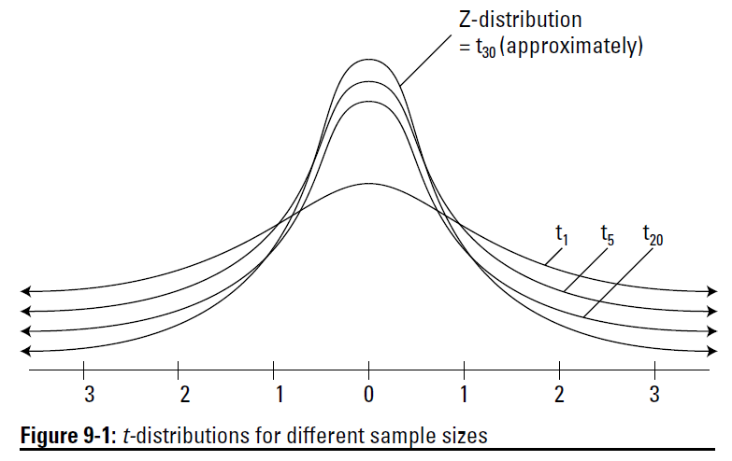
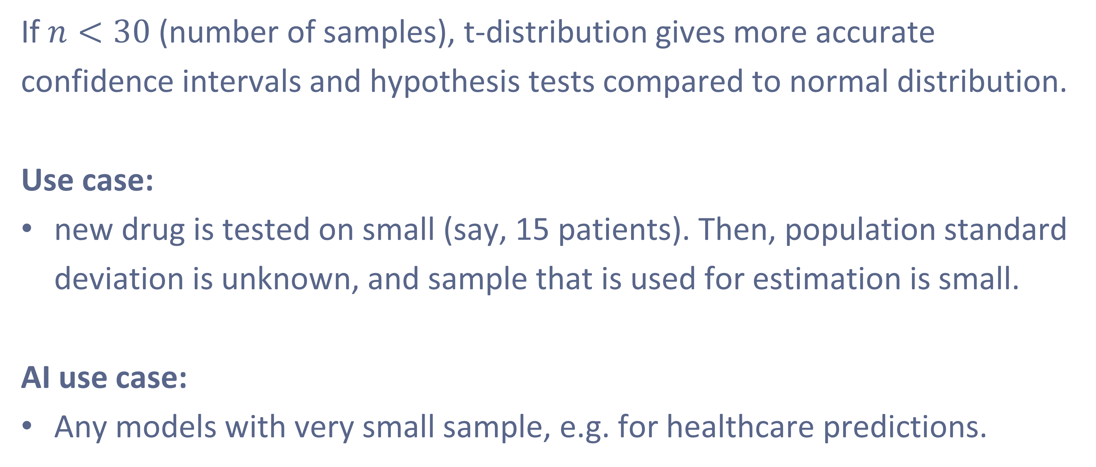
Students‘ t-distribution
is used when sample size is small or when population standard deviation is unknown. It is similar to normal distribution, but with heavier tails, e.g. more flat.
If $n<30$ (number of samples), t-distribution gives more accurate confidence intervals and hypothesis tests compared to normal distribution.
Use case:
new drug is tested on small (say, 15 patients). Then, population standard deviation is unknown, and sample that is used for estimation is small.
AI use case:
Any models with very small sample, e.g. for healthcare predictions.

Slide 34
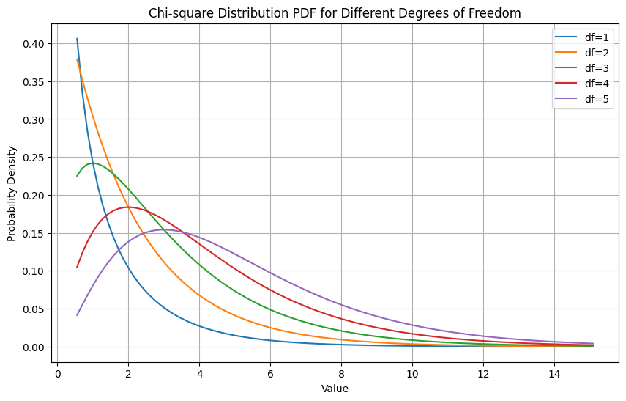

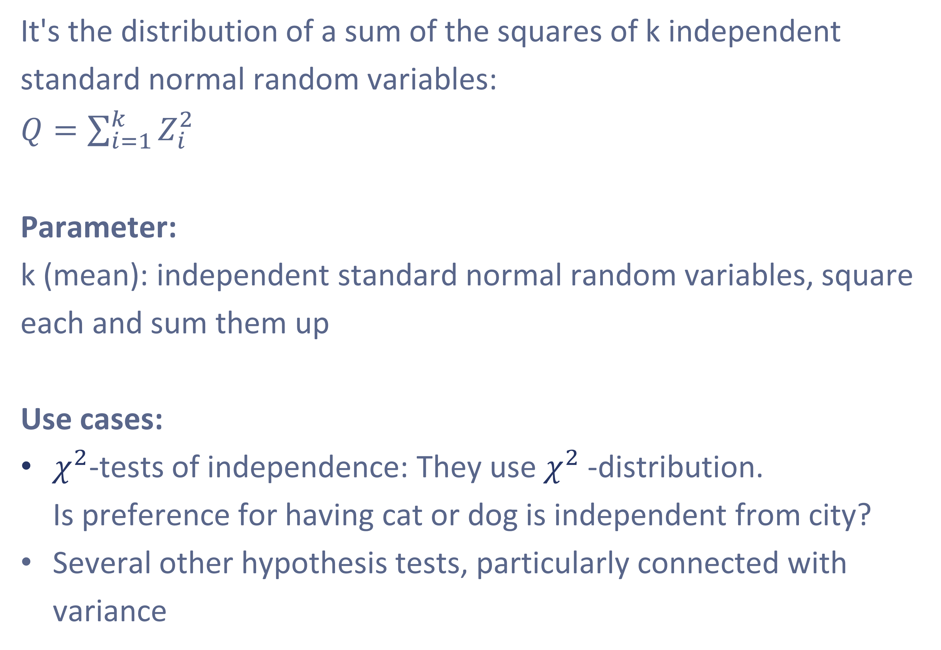
$χ^{2}$distribution
is a probability distribution of the sum of squares of independent standard normal random variables and is important particularly in the context of variance
It's the distribution of a sum of the squares of k independent standard normal random variables: $Q=\sum_{i=1}^{k}{Z_{i}^{2}}$
Parameter:
k (mean): independent standard normal random variables, square each and sum them up
Use cases:
$χ^{2}$-tests of independence: They use $χ^{2}$-distribution. Is preference for having cat or dog is independent from city?
Several other hypothesis tests, particularly connected with variance
https://en.wikipedia.org/wiki/Chi-squared_distribution

Slide 35
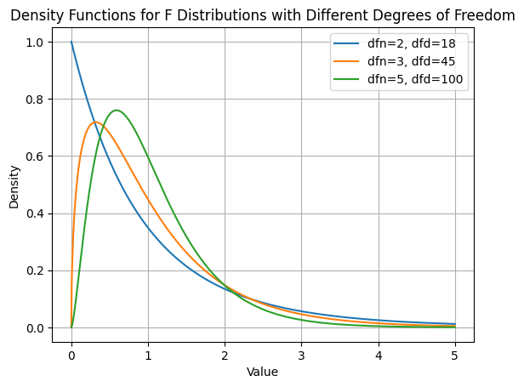
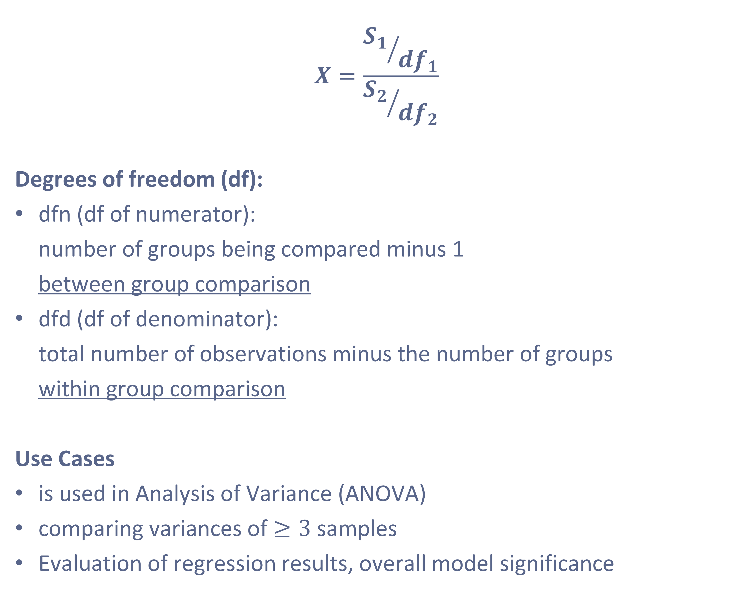
F-distribution
is ratio of 2 independent $χ^{2}$-distributions divided by their respective degrees of freedom
$$X=\frac{{S_{1}}/{{df}_{1}}}{{S_{2}}/{{df}_{2}}}$$
Degrees of freedom (df):
dfn (df of numerator): number of groups being compared minus 1 between group comparison
dfd (df of denominator): total number of observations minus the number of groups within group comparison
Use Cases
is used in Analysis of Variance (ANOVA)
comparing variances of $≥3$ samples
Evaluation of regression results, overall model significance
https://en.wikipedia.org/wiki/F-distribution

Slide 36
Exercises
Exercise 1:
Problem: You are about to flip a coin five times. The probability of getting heads (success) is 0.5. What is the probability of getting 3 heads?
Exercise 2:
Problem: A manufacturer knows that 10% of his products are defective. He sells products in boxes of 20. What is the probability that a box will contain exactly 2 defective products?
Exercise 3:
Problem: A multiple-choice quiz contains 10 questions. Each question has four possible answers, of which one is correct. If a student guesses the answer to each question at random, what is the probability that the student will answer exactly 4 questions correctly?
Exercise 4:
Problem: A fast food restaurant serves an average of 10 customers every 15 minutes. What is the probability of serving exactly 7 customers in a 15 minute interval?
Exercise 5:
Problem: An IQ test is scored such that the mean score is 100 and the standard deviation is 15. What is the probability of a person scoring higher than 130?
Exercise 6:
Problem: A sample of 20 students' test scores has a mean of 76 and a standard deviation of 10. What is the probability of a student scoring less than 70?
Extra-exercises: Relevant use cases are in context of hypotheses and model estimation
Exercise 7:
Suppose the variance of a sample of 20 observations is 5. What is the probability that the sample variance is greater than 6?
Exercise 8:
If two groups of data are sampled from normal distributions with the same variance, the ratio of their sample variances will follow an F-distribution. Suppose you have two samples of sizes 15 and 20 with variances 4 and 2, respectively. What is the probability that the ratio of these sample variances is less than 1?

Slide 37
5. Conditional probability
is the probability of an event occurring given that another event has already occurred
Formula of Bayes
Table with conditional probabilities
Exercises
37

Slide 38
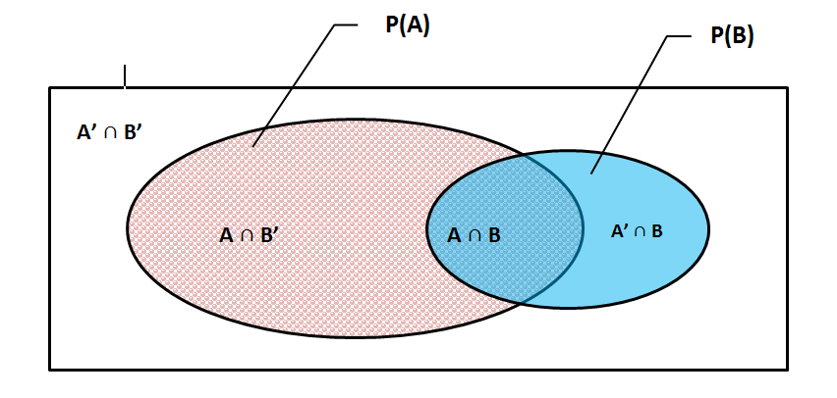


Bayes‘ theorem
describes how to update the probabilities of hypotheses when given evidence. It’s is used to calculate the conditional probability, i.e., the probability of an event based on prior knowledge.
From conditional probabilities to Bayesian theorem:
$P\left(A|B\right)=\frac{P\left(A and B\right)}{P\left(B\right)}$
$P\left(B|A\right)=\frac{P\left(B and A\right)}{P\left(A\right)}$
$P\left(A and B\right)=$ $P\left(B and A\right)$
Thus: $P\left(A|B\right)P\left(B\right)=P\left(B|A\right)P\left(A\right)$
Or:
$P\left(A|B\right)=\frac{P\left(B|A\right)P\left(A\right)}{P\left(B\right)}$
38

Slide 39


Table with conditional probabilities
Use Case: How many visitors make a purchase depending on whether they visit website A or B
 | Purchase | No Purchase | Total (MP)
Website A | 80 (A1) JP: 4 % CP: 8 % | 920 (A2) JP: 46 % CP: 92 % | $Total_A$ 1000 $P\left(A\right)=$50%
Website B | 90 (B1) JP: 4.5 % CP: 9 % | 910 (B2) JP: 45.5 % CP: 91 % | $Total_B$ 1000 $P\left(B\right)=$50%
Total (MP) | Purchase: 170 (T1) P(Purchase) = 8.5% | Non-purchase: 1830 (T2) P(Non-Purchase) = → 91.5 % | $Total=Total_A+Total_B$ 2000 $P\left(Total\right)=100\%$
Joint probabilities (JP):
P(A and Purchase) = A1; T = 80 / 2000 = 0.04
P(B and Purchase) = B1; T = 90 / 2000 = 0.045
Conditional probabilities (CP):
P(Purchase | A) = A1; TA = 80 / 1000 = 0.08 (probability of a purchase given the user saw website A)
P(Purchase | B) = B1; TB = 90 / 1000 = 0.09 (probability of a purchase given the user saw website B)
Marginal probabilities (MP):
P(A) = TA; T = 1000 / 2000 = 0.5 (probability a visitor sees website A)
P(B) = TB; T = 1000 / 2000 = 0.5 (probability a visitor sees website B)
P(Purchase) = T1; T = 170 / 2000 = 0.085 (probability a visitor makes a purchase)
$$P\left(Purchase given Website A\right)=\frac{P\left(Website A given Purchase\right)∗P\left(Purchase\right)}{P\left(Website A\right)}$$
$$0.08=\frac{{80}/{170}∗0.085}{0.5}$$
39

Slide 40
Exercises
Exercise 1:
Consider the following frequency table for students' preferences for Programming Language and whether they prefer Dark Theme or not
Programming Language | Dark Theme | Count
Python | Yes | 90
Python | No | 30
Java | Yes | 50
Java | No | 40
JavaScript | Yes | 60
JavaScript | No | 30
Represent this table in Python using a list of dictionaries and calculate the conditional probability of a student preferring a Dark Theme given that they prefer Python, Java, JavaScript.

Slide 41
6. Sampling
is the process of selecting a subset of individuals from a statistical population to estimate characteristics of the whole population
Central Limit Theorem (CLT)
Confidence intervals
Resampling
Bootstrapping
Exercises
41

Slide 42

Central limit theorem
states that for large number of iid random variables, the distribution of their sum (or average) tends toward a normal distribution, irrespective of shape of original population distribution
Definition:
For population with mean μ and standard deviation σ
take sufficiently large random samples from the population
with replacement (independent)
Independent and identically distributed (i.i.d) random variables
Sample size is large enough (typically n > 30)
→ distribution of sample means is appr. normally distributed, regardless of population distribution
Why is it important?
This principle enables us to make statistical inferences about populations based on sample data
foundation for hypothesis testing, confidence intervals, etc.

Slide 43


Confidence intervals
are a range of values estimated to contain the value of unknown population parameter with certain degree of confidence, widely used e.g. for hypothesis testing
Confidence Interval for Mean: $\overline{x}±\left(Z×\frac{s}{\sqrt{x}}\right)$
with:
x̄ is the sample mean
Z is the Z-score, i.e. desired level of confidence (e.g., 1.96 for 95% confidence)
s: standard deviation of the sample
n is the sample size
Confidence Interval for Variance:
Based on $χ^{2}$ and complicated
Central Limit Theorem:
allows to use normal distribution for confidence interval estimation when the sample size is large, even if the original population is not normally distributed.

Slide 44


Confidence intervals
… need careful interpretation. Assumption: $α=5\%$
Assumption: population parameter $μ$ (average of population) is fixed
Wrong interpretation:
With a chance of 95% the confidence interval contains $μ$
Correct interpretation:
If sampling process is repeated many times or infinitely
confidence intervals are generated each time
95% of these confidence intervals contain $μ$

Slide 45
Resampling
Is set of methods of statistical inference that involve drawing repeated samples from original data samples
What is it good for? | Versatile method to make statistical inferences about a dataset It helps to validate models by using random subsets (bootstrap) or sequences (cross-validation) dataset It extends possibilities for hypothesis testing and estimation
Example: Bootstrap | Many resamples (with replacement) of the observed dataset are generated Arbitrary distribution is transformed into normal distribution convenient for estimation and hypothesis testing.
Example: Cross-validation | a form of resampling used to prevent overfitting in machine learning models dataset is divided into 'k' subsets; used for training the model respective residual data is used as test set

Slide 46

Bootstrapping
is a resampling method that involves drawing repeated samples from the original data set, with replacement. Each sample drawn is the same size as the original dataset.
Procedure:
Draw sample from the original dataset with replacement
Often of same size like original dataset
Compute desired statistic from this resample
Repeat the process multiple times (often thousands or tens of thousands of times), each time storing the statistic.
Use distribution of these bootstrapped statistics to make inferences about the population.
Why does it make sense?
It provides method to estimate variability or confidence intervals of statistic when underlying distribution is unknown or complex.
It's a simple and powerful method requiring very few assumptions
AI Use case:
Random forests (like XGBoost): Classification or numeric prediction based on many resampled pruned decision trees
With repetition

Slide 47
Exercises
Exercise 1
Implement a python function called central_limit_theorem that accepts three arguments: population_data, sample_size, and num_of_samples. Your function should simulate the central limit theorem. The function should draw the specified number of samples of the given size from the population data, calculate the means of these samples, and return a list of these means.
Test this function using a randomly generated population data. Plot the distribution of sample means and the mean of the population.
Exercise 2
Implement a python function called confidence_interval that accepts two arguments: data and confidence. Your function should calculate and return the confidence interval of population mean for the given data at the specified confidence level.
Test your function on a randomly generated data.
Exercise 3
How does the confidence interval of variance look like?
Exercise 4
Implement a python function called bootstrap that accepts three arguments: data, num_samples, and statistic. Your function should perform bootstrap sampling on the data (resampling with replacement) the specified number of times, applying the provided statistical function to each sample, and return an array of the calculated statistic for each sample.
Test this function using a randomly generated data and numpy's mean as the statistic. Calculate and print the mean and standard deviation of the bootstrap samples' statistic.

Slide 48
7. Hypothesis testing
describe the probabilities of occurrences of different possible outcomes in an experiment
Hypothesis Testing
One-sided vs. Two-sided tests
p-Value
Errors: False positives and false negatives
A/B Testing
Examples: t-, $χ^{2}$-, ANOVA- tests
Exercises
48

Slide 49


Hypothesis testing
is a statistical method used to assess the evidence from sample data and make conclusions about a population by comparing competing hypotheses.
It involves formulating two competing hypotheses
the null hypothesis ($H_{0}$): initial claim, status quo, which usually means: No effect/difference
and the alternative hypothesis ($H_{1}$); we want evidence for the alternative hypothesis
We assess evidence from the data, in order to determine whether to reject or fail to reject the null hypothesis.
49

Slide 50


Hypothesis testing
involves specifying significance level, analyzing sample data using statistical test rejecting or not rejecting null hypothesis
Workflow:
State Hypotheses: Null Hypothesis ($H_{0}$) and Alternative Hypothesis ($H_{1}$)
Specify critical value $α$: usually 0.05 for 2-sided tests
Calculate test statistic t with:
t-test
$χ^{2}$-test
z-test
ANOVA-test, and many more
Interpret results comparing t and $α$:
Reject null hypothesis (support $H_{1}$) or not (support $H_{0}$)?

Slide 51


One-sided vs. Two-sided tests
One-sided hypothesis test checks if parameter is greater/less than a certain value.
Two-sided test checks if parameter is not equal to a certain value, regardless of direction.
Two-sided (or Two-tailed) Tests
… assess if a parameter is either greater or less than the null hypothesis value.
Example: Company is testing if a website redesign affects, i.e. either increases or decreases user time on site.
$H_{0}$: Website redesign has no effect on user time on site.
$H_{1}$: Website redesign affects user time on site.
One-sided (or One-tailed) Tests
… check if parameter is either greater or less than null hypothesis value, but not both.
Example: Pharmaceutical company is testing a new drug and wants to know if it reduces disease recovery time (not interested if it increases).
$H_{0}$: Drug does not reduce recovery time.
$H_{1}$: Drug reduces recovery time.

Slide 52


Deciding to reject $H_{0}$or not
is standardized procedure like an “API”
Initial assumption: “There is no effect”, i.e. we don’t reject $H_{0}$yet
Samples from population vary around the population mean $μ$
Theoretical probability of samples
around $μ$ (or further away, the integral) is high
far away from $μ$ (or even further, the integral) is low
Now you take the real sample and focus on distance from $μ$
If it is very close
sample is not extreme
theoretical probability of getting more extreme sample is high
we say: “There is no effect, there is not enough evidence to reject $H_{0}$”
simpler: “We choose $H_{0}$”
If it is very far
sample is extreme
theoretical probability of getting more extreme sample is low
we say: “There is an effect, there is enough evidence to reject $H_{0}$”
simpler: “We choose $H_{1}$”
We decide based on this integral. How is it called?

Slide 53


p-value
is a tool for deciding whether to reject or not reject the null hypothesis
Interpreting the P-value
Small p-value (typically ≤ $α=0.05$) suggests strong evidence against the null hypothesis, “we reject the null”, “we support $H_{1}$”
Large p-value $α=0.05$) suggests weak evidence against the null hypothesis, “we fail to reject the null”, “we support $H_{0}$”
If we reject the null, there is typically significant difference between the 2 groups
Properties
p-values can be affected by the size of the sample.
Figure: in 0.72 of 100 times you should have selected $H_{0}$.
Example for rejecting $H_{0},$ the 2 groups are different

Slide 54


Errors: False positives and false negatives
matter, as they represent incorrect conclusions that can impact decisions based on test results
Selecting $H_{1}$ is the “positive” statement
Selecting $H_{0}$ is the “negative” statement
Type I error means “false positive”:
When $H_{0}$ is true and therefore “selecting $H_{1}$ is incorrect”
precise formulation: $H_{0}$ is incorrectly rejected
Type II error means false negative:
When the $H_{0}$ is false, but “we select it”
precise formulation: we fail to reject it
Connection to significance level $α$:
The maximal probability of making Type I error is defined by $α$, such as 0.05 or 0.01.

Slide 55


What is A/B-Testing?
also known as split testing, is method of comparing two versions of webpage, email, or other user experience to determine which one performs better.
Identify goal: Your goal might be to increase website conversions, improve email click-through rates, or boost the number of sign-ups.
Create Variants: Develop two versions of element you want to test - the control (A) and the variant (B). The versions should be identical except for one change.
Split audience: Randomly divide audience into two equal groups. One sees version A, the other sees B.
Conduct test: Release both versions at the same time and collect data on how each version performs in relation to your goal.
Analyze the Results: Use statistical analysis to determine which version performed better.
Implement Changes: If B performs significantly better, consider replacing version A with B.
https://medium.com/towards-data-science/data-science-you-need-to-know-a-b-testing-f2f12aff619a

Slide 56

A/B Testing: Choosing the Right Test Type
Tests types are nuanced, slight differences in hypothesis determine selection
Test Type | Scipy method | Use Case, compare: | Examples
1. Two sample t | ttest_ind | means of continuous data between two groups of independent samples | Company tests new website B and compares it with old one A Visitors are divided into 2 groups that only see one of them Visit durations are measured → Does the subgroup stay longer on new website B?
2. Paired t | ttest_rel | means of continuous data for the same group at different times | Like 1 But: The same group is tested Visit durations are measured, first with website A later with B → Does the same group stay longer on new website B?
3. $χ^{2}$ for independence | chi2_contingency or chi2.sf | Variance of categorical data between two or more groups | A company has employees in 4 experience levels On each level a part of them received promotion (yes/no) → Does experience level have impact on promotion?
4. One factor ANOVA | f_oneway | means of continuous data between $≥$ three groups of independent samples | Education program in company, 3 learning styles: self-paced online courses, instructor led, mixed Employees are divided in 3 subgroups → Does the learning style have impact on learning success?

Slide 57

Two sample t-tests
are statistical tests used to compare the means of continuous data between two groups
and determine if they are significantly different from each other.
The formula for the t-statistic in a two-sample t-test is:
$t=\frac{{\overline{X}}_{1}−{\overline{X}}_{2}}{\sqrt{\frac{s_{1}^{2}}{n_{1}}+\frac{s_{2}^{2}}{n_{2}}}}$
With:
${\overline{X}}_{1}$and ${\overline{X}}_{2}$ are the sample means of the two groups
$s_{1}^{2}$ and $s_{2}^{2}$ are the sample variances of the two groups.
$n_{1}$ and $n_{2}$ are the sample sizes of the two groups
Degrees of freedom: $df=n_{1}+n_{2}−2$
Variant A: No significant difference
# Randomly generating test scores for Group A and Group B
np.random.seed(0) # for reproducibility
group_A_scores = np.random.normal(75, 10, 30)
group_B_scores = np.random.normal(80, 10, 30)
→ df = 58
Variant B: Significant difference
# Randomly generating test scores for Group A and Group B
np.random.seed(0) # for reproducibility
group_A_scores = np.random.normal(75, 10, 30)
group_B_scores = np.random.normal(90, 10, 30)
→ df = 58

Slide 58


Two sample t-tests
are statistical tests used to compare the means of continuous data between two groups
and determine if they are significantly different from each other.
Critical value: 2.001 (2-sided!)
ttest_stat = 0.8897
ttest_stat = 2.9389
H0:
There is no evidence that subgroup B stays longer on the website …
H1:
There is evidence that subgroup B stays longer on the website …

Slide 59

Paired t-tests
are used when you want to compare the means of continuous data for the same group at two different times or under two different conditions
The formula for the t-statistic in a paired t-test is:
$t=\frac{\overline{D}}{{s_{D}}/{\sqrt{n}}}$
With:
$\overline{D}$ is the mean of the differences between the paired observations.
$s_{D}$is the standard deviation of the differences between the paired observations.
$n$ is the number of pairs.
Degrees of freedom: $df=n−1$
Variant A: No significant difference
# Randomly generating test scores for Group A and Group B
np.random.seed(0) # for reproducibility
group_A_scores = np.random.normal(75, 10, 30)
group_B_scores = np.random.normal(80, 10, 30)
→ df = 29
Variant B: Significant difference
# Randomly generating test scores for Group A and Group B
np.random.seed(0) # for reproducibility
group_A_scores = np.random.normal(75, 10, 30)
group_B_scores = np.random.normal(100, 10, 30)
→ df = 29

Slide 60


Paired t-tests
are used when you want to compare the means of continuous data for the same group at two different times or under two different conditions
paired_t_stat = 0.8090
Critical value: 2.0452 (2-sided!)
paired_t_stat = 6.1540
H0:
There is no evidence that group stays longer on the new website …
H1:
There is evidence that group stays longer on the new website …

Slide 61




$χ^{2}$ independence test
statistical tests used to determine if there's a significant association between two categorical variables in a sample.
The test statistic for a chi-square test is calculated as:
$$χ^{2}=\sum{\frac{{\left(O_{i}−E_{i}\right)}^{2}}{E_{i}}}$$
$O_{i}$ are the observed frequencies
$E_{i}$ are the expected frequencies
Where

Slide 62



$χ^{2}$ independence tests
statistical tests used to determine if there's a significant association between two categorical variables in a sample.
Critical value: 26.2962
Chi^2_stat = 23.5172
Chi^2_stat = 46.7812
H0:
Experience level does not have significant impact on promotion…
H1:
Experience level has significant impact on promotion…

Slide 63
Oneway – analysis of variance test
statistical tests used to compare the means of three or more groups and determine if they are significantly different from each other.
Group 1 | Group 2 | Group 3
82 | 71 | 64
93 | 62 | 73
61 | 85 | 87
74 | 94 | 91
69 | 78 | 56
70 | 66 | 78
53 | 71 | 87
Mean | Mean | Mean | Overall mean
71,71 | 75,29 | 76,57 | 74,52
N_Total | 21
Num_Groups | 3
N_per_Group | 7
N_per_Group - 1 | 6
alpha | 5%
 | df | SS | MS | F_stat
Between (SSC) | 2 | 88,66667 | 44,33333333 | 0,283726128
Within (SSE) | 18 | 2812,571 | 156,2539683
Total (SST) | 20 | 2901,238
The larger the differences between the group samples the larger F_stat
Exceeding F_crit, we “reject the null” (H1)
F_crit(5%, 2, 18) | 3,554557146
F_stat | 0,283726128
F_stat < F_crit
H0 is not rejected (“H0”)

Slide 64


Oneway – analysis of variance test
statistical tests used to compare the means of three or more groups and determine if they are significantly different from each other.
F_stat = 0.2837
Critical value: 3.5545
F_stat = 4.4822
H0:
The learning style has no significant impact on learning success …
H1:
The learning style has significant impact on learning success …

Slide 65
Exercises
Exercise for ttest_ind:
Based on the ttest_ind example, try new data points and find data point configurations, where H0 is very close of being rejected or is just rejected. Generate figure according to the given figures.
Exercise for ttest_rel:
Based on the ttest_ind example, try new data points and find data point configurations, where H0 is very close of being rejected or is just rejected. Generate figure according to the given figures.
Exercise for chi^2:
→ Next slide
Exercise for F:
Based on the F example, try new data points and find data point configurations, where H0 is very close of being rejected or is just rejected. Generate figure according to the given figures.
Additional exercise for chi^2:
Based on the chi^2 example, try new data points and find data point configurations, where H0 is very close of being rejected or is just rejected. Generate figure according to the given figures.

Slide 66

Exercise – Chi squared
$H_{0}$: Bugs have no preference of moving to one or the other bins
$H_{1}$: Or do we have enough evidence to reject $H_{0}?$
Nr | Obs
1 | 5
2 | 17
3 | 7
4 | 3
Source:
https://www.youtube.com/watch?v=qYOMO83Z1WU&t=552s

Slide 67
8. Model estimation
is the process of determining the parameters of statistical model that best fit observed data
From Variance to Covariance to Correlation
Parameter estimation in linear models
Overfitting vs. underfitting
Estimation of linear model
Linear regression + model evaluation
Logistic regression + model evaluation
Exercises
67

Slide 68


From Variance to Covariance to Correlation
Covariance is a generalization of variance to multiple dimensions or variables.
Correlation is a normalized form of covariance to have values between -1 and +1.
Variance ($ο^{2}$):
Measures how far a set of numbers spread out from mean.
In the figure: The diagonal
Covariance:
Measures how much two random variables vary together.
In the figure: The triangles above and below the diagonal
Correlation:
Standardized measure of the relationship between two variables
ranging from -1 (perfect negative correlation) to +1 (perfect positive correlation), e.g. it is the normalized covariance.
https://medium.com/@raghavan99o/scatter-matrix-covariance-and-correlation-explained-14921741ca56

Slide 69

Correlation
is the standardized measure of the relationship between two variables
Positive Correlation:
When two variables increase or decrease together.
For example, the more time spent studying (variable 1), the higher the grades (variable 2). Correlation value ranges from 0 to +1.
Negative Correlation:
When one variable increases as the other decreases.
For example, the more time spent watching TV (variable 1), the lower the grades (variable 2). Correlation value ranges from 0 to -1.
Source:
https://en.wikipedia.org/wiki/Correlation

Slide 70

Pearson’s Correlation Coefficient - Test
Tests whether two samples have a linear relationship.
Assumptions
Observations in each sample are independent and identically distributed (iid).
Observations in each sample are normally distributed.
Observations in each sample have the same variance.
Interpretation
H0: the two samples are independent.
H1: there is a dependency between the samples.
# Example of the Pearson's Correlation test
from scipy.stats import pearsonr
data1 = [0.873, 2.817, 0.121, -0.945, -0.055, -1.436, 0.360, -1.478, -1.637, -1.869]
data2 = [0.353, 3.517, 0.125, -7.545, -0.555, -1.536, 3.350, -1.578, -3.537, -1.579]
stat, p = pearsonr(data1, data2)
print('stat=%.3f, p=%.3f' % (stat, p))
if p > 0.05:
print('Probably independent')
else:
print('Probably dependent')
Source:
https://machinelearningmastery.com/statistical-hypothesis-tests-in-python-cheat-sheet/

Slide 71


Parameter estimation in linear models
involves finding the coefficients that best fit the observed data, i.e. represent the relationship between two correlated variables (X and Y)
Simple linear regression model:
$Y=β_{0}+β_{1}∗X+ε$
$β_{0}$ (intercept) and $β_{1}$ (slope) are the parameters to be estimated.
$β_{0}$: Value of Y when X = 0.
$β_{1}$ : Change in Y for each one-unit change in X.
Use Cases:
Generalization of sample data to overall population data
Forecasting like prediction of house prices based on independent features
https://vitalflux.com/generalized-linear-models-explained-with-examples/

Slide 72


Ordinary Least Squares (OLS) estimation
represents a relationship between two correlated variables (X and Y) and is used in linear regression analysis
Ordinary Least Squares (OLS) estimation:
Method used in linear regression to estimate the model's parameters
by minimizing the sum of the squares of the differences between the observed and predicted values of the dependent variable.
Separation systematic relations from white noise
IID & BLUE:
If the residuals are identically and independently distributed (iid) the OLS estimator is used, because it provides best linear unbiased (BLUE) estimation.
https://gregorygundersen.com/blog/2020/01/04/ols/

Slide 73




OLS - What if IID-ness of residuals is violated?
Here it gets interesting ☺
Heteroscedasticity
Variance is not identical
Breusch-Pagan-Test: $H_{1}$means that there is enough evidence from residuals to assume heteroscedasticity
Autocorrelation (typical example: time series)
Residuals depend on precedessors
Durbin-Watson-Test:
Transformations can be used in order to make OLS estimation usable...

Slide 74

Overfitting
is a modeling error where a model is trained too well on the training data
Problems associated with Overfitting:
Poor Generalizability:
Overfit models perform well on training data but poorly on new, unseen data, which limits their predictive accuracy.
Complexity:
Overfitting often results in overly complex models that have too many parameters.
Unreliable Predictions:
Overfit models are sensitive to minor fluctuations in data, leading to unreliable, inconsistent predictions over time.

Slide 75

Overfitting vs. underfitting
In opposite to overfitting, underfitting is when the model fails to capture important trends in the training data, resulting in poor performance on both the training and unseen data.
Underfitting:
Occurs when a model cannot adequately capture the underlying structure of the data. It's oversimplified, has poor predictive performance on both training and unseen data due to high bias.
What is worse?
Both overfitting and underfitting lead to poor predictions and indicate that the model may not be the right choice or needs fine-tuning.

Slide 76



R-squared: Goodness of fit
is a statistical measure in regression models that represents the proportion of the variance in the dependent variable that is predictable from the independent variables
Properties:
Ranges from 0 to 1.
Value of 1 → independent variable(s) perfectly predict dependent variable.
Value of 0 → no predictive power.
Higher R-Squared values → better fit, however very high R-Squared indicates overfitting.
Only interpretable in the context of the data and domain. Low R-Squared could be acceptable in some fields where prediction is difficult.
Adjusted R-squared:
Problem to be solved: Many input factors may improve fit, but lead to multicoliniarity, overfitting etc.
In order to incentivate leaner models, number of input factors is punished
$R^{2}=1−\frac{SSR}{SST}$-

Slide 77

Statsmodels: Summary for OLS
Goodness of fit
provides a comprehensive summary of the results from fitted OLS model
Model Info
The closer to 1 the better
The smaller the better
The closer to 0 the better
The smaller the better
Autocorrelation,
e.g. basis of time series
Coefficients Table
skewness and kurtosis
multicollinearity

Slide 78

Statsmodels: Summary – Coefficients table
provides detailed information about each parameter in the model
coef:
Estimates of the parameters
t:
t-statistic value
Ratio: coefficient / std. err
measure of how statistically significant the coefficient is.
[0.025 0.975]
95% confidence intervals for the coefficient.
If zero is not in this interval, that suggests the variable is a significant predictor at the 0.05 level.
std err:
Standard error of the estimate of the coefficient
not standard deviation!
Smaller values indicate a more precise estimate.
P>|t|:
p-value associated with the t-statistic.
Smaller p-value (<0.05, traditionally) suggests that null hypothesis can be rejected, i.e. independent variable is a significant predictor of dep. variable.

Slide 79


Logistic regression
is a statistical model to predict a binary outcome (0 or 1, true or false) based on one or more predictor variables, using the logistic function to model the probability of the binary outcome.
Logistic function (= sigmoid function):
$P\left(z\right)=\frac{1}{1+e^{−z}}$ with $z{=β_{0}+β_{1}x}$
It converts any input into a value between 0 and 1, which can be interpreted as a probability.
For given input 'x', the output represents probability that 'x' belongs to class 1 (usually coded as positive outcome).
Simple rounding can be used for predicting 0 or 1
It is based on …
Logged odds:
$$\ln\left(\frac{p}{1−p}\right)=β_{0}+β_{1}x$$
→ Linear model is projected on S-curve
Fig 12: Typical logistic regression curve
https://medium.com/@cmukesh8688/logistic-regression-sigmoid-function-and-threshold-b37b82a4cd79

Slide 80

Statistics perspective: Summary for Logistic regression
provides a comprehensive summary of the results from fitted logistic regression model
The closer to 1 the better
The closer to 0 the better
If LLR p-value is small (typically less than a pre-specified significance level, such as 0.05), full model provides significantly better fit to the data compared to reduced model.
coef:
Input factors that have impact and should be used

Slide 81

ML perspective: Train test split
is a method where the dataset is divided into subsets: the training set, used to train the model, and the testing set, used to evaluate the model's performance on unseen data
Training models vs. analytical solution
Logistic regression does not have analytical solution in opposite to linear regression.
Therefore squared error minimizing parameters are approximated, e.g. with Newton’s approximation method
However: Danger of overfitting
Training Set:
Portion of data used to create the model, i.e. to learn/approximate the parameters
Usually 70-80% of the entire dataset
Testing Set:
Subset of data that the model has not seen during learning phase
Used to evaluate performance of the model on unseen data and check for overfitting. Typically 20-30% of entire dataset
https://medium.com/@rathinavel.mph/how-the-train-and-test-samples-are-split-d7e46a8e2361
81

Slide 82


Logistic regression
is a statistical model to predict a binary outcome (0 or 1, true or false) based on one or more predictor variables, using the logistic function to model the probability of the binary outcome.
Logistic function (= sigmoid function):
$P\left(z\right)=\frac{1}{1+e^{−z}}$ with $z{=β_{0}+β_{1}x}$
It converts any input into a value between 0 and 1, which can be interpreted as probability.
For given input 'x’, output represents probability that 'x' belongs to 1
Simple rounding can be used for predicting 0 or 1
It is based on …
Logged odds:
$$\ln\left(\frac{p}{1−p}\right)=β_{0}+β_{1}x$$
→ Linear model is projected on S-curve

Slide 83

Confusion matrix
is a tabular representation to visualize the performance of a predictive model on a set of test data for which the true values are known.
True Positives (TP): These are cases in which we predicted yes (they have the condition), and they do have the condition.
True Negatives (TN): We predicted no, and they don't have the condition.
False Positives (FP): We predicted yes, but they don't actually have the condition. (Also known as a "Type I error.")
False Negatives (FN): We predicted no, but they actually do have the condition. (Also known as a "Type II error.")
Accuracy:
Ratio of correctly predicted observation to the total observations
Accuracy = (TP + TN) / (TP + FP + FN + TN)
However misleading in case of imbalanced classes: “Sun in July in Greece”, highly accurate prediction, but no indicator of good prediction model
Precision:
What proportion of positive identifications was actually correct?
Precision = TP / (TP + FP)
Better, because false positives should be reduced!

Slide 84

Accuracy rate and error rate
Try to improve your model by reducing false positives (Error Type I)

Slide 85

Cumulative Accuracy Profile (CAP) curve
illustrates the cumulative number of positive outcomes along different thresholds of classification
Key Components
Random Model line: Represents a random guess model.
Perfect Model line: Achieves 100% identification of true positives with no false positives.
Logistic Regression Model line: Represents the actual model's cumulative accuracy profile.
50% Rule
y < 60%: model might not be beneficial.
y is between 60% and 70%: model is good.
y > 70%: model possibly too good, indication of overfitting
Y-axis: Cumulative percentage of positive samples.
X-axis: Cumulative percentage of total samples.

Slide 86
Exercises
Exercise for linear regression:
Generate data with 5 input factors and numeric output
Generalize it with OLS Estimator
Exercise for logistic regression:
Take the dataset “default of credit card clients”
Develop model for binary classification by generalizing the dataset
Discuss summary, confusion matrix and cap curve
Exercise for hypothesis tests:
Create example for Peason’s Correlation test with data from random generator

Slide 87
Outlook – Machine learning
This lecture is reference point for different machine learning topics
Supervised Learning, i.e. generalization:
numeric regression
Classification
time-series prediction
Logistic regression:
ROC-AUC-Curve, F-Score, etc.
Application: Deep Learning
Reinforcement learning, i.e. exploratory controlling/steering:
Different A-B-testing approach
87

Slide 88

Statistical tables
let you decide whether to reject $H_{0}$
or not by hand
88

Slide 89

Statistical tables
let you decide whether to reject $H_{0}$
or not by hand
89

Slide 90

Statistical tables
let you decide whether to reject $H_{0}$ or not by hand
90

Slide 91

Statistical tables
let you decide whether to reject $H_{0}$
or not by hand
91

Slide 92
Links
i.e. sources for self-learning
Descriptive statistics
 | Variance | https://www.youtube.com/watch?v=JgMFhKi6f6Y
 | Quantiles | https://docs.eggplantsoftware.com/epp/9.4.0/analyzer/analyzer-understanding-charts-events.htm
 | Python Data Visualization Tutorial | https://www.youtube.com/watch?v=Nt84_TzRkbo
Combinatorics
 | Introduction to Permutations and Combinations | https://www.youtube.com/watch?v=gAnKvHmrJ0g
 | Miracles of Pascal‘s triangle | https://www.youtube.com/watch?v=J0I1NuxUcpQ
Distributions
 | Uniform probability distributions | https://www.youtube.com/watch?v=aCW8wm6nrRw
 | Binomial distribution | https://www.youtube.com/watch?v=6YzrVUVO9M0
 | Chi^2 | https://www.youtube.com/watch?v=JCOeytq7F0E

Slide 93
Links
i.e. sources for self-learning
Conditional probability
 | Bayes' Theorem of Probability With Tree Diagrams & Venn Diagrams | https://www.youtube.com/watch?v=OByl4RJxnKA
 | What is the Bayes’ Theorem? | https://medium.com/mlearning-ai/what-is-the-bayes-theorem-545a2ef0b91c
 | Data Science. Bayes theorem | https://luminousmen.com/post/data-science-bayes-theorem
 | Bayesian Machine Learning in Python: A/B Testing | https://www.udemy.com/course/bayesian-machine-learning-in-python-ab-testing
Sampling
 | Central limit theorem | https://www.geeksforgeeks.org/python-central-limit-theorem
 | Confidence intervals | https://data.library.virginia.edu/the-intuition-behind-confidence-intervals/
 | Resampling | https://www.linkedin.com/pulse/resampling-methods-pranshu-jaryal
 | Bootstrapping | https://www.youtube.com/watch?v=9IFcRTyhd5Y
 |  | https://dgarcia-eu.github.io/SocialDataScience/2_SocialDynamics/025_Bootstrapping/Bootstrapping.html
 |  | https://janhove.github.io/teaching/2016/12/20/bootstrapping

Slide 94
Links
i.e. sources for self-learning
Hypothesis testing
 | Bayesian Machine Learning in Python: A/B Testing | https://www.udemy.com/course/bayesian-machine-learning-in-python-ab-testing
 | Introduction to the Chi-square Test | https://www.youtube.com/watch?v=SvKv375sacA
 | F-ratio Test for Two Equal Variances | https://www.youtube.com/watch?v=UWQO4gX7-lE
 | 17 Statistical Hypothesis Tests in Python (Cheat Sheet) | https://machinelearningmastery.com/statistical-hypothesis-tests-in-python-cheat-sheet/
 | Chi Squared Testing | https://www.youtube.com/watch?v=qYOMO83Z1WU
94

Slide 95
Links
i.e. sources for self-learning
Model estimation
 | Scatter matrix , Covariance and Correlation Explained | https://medium.com/@raghavan99o/scatter-matrix-covariance-and-correlation-explained-14921741ca56
 | Logistic regression sigmoid function and threshold | https://medium.com/@cmukesh8688/logistic-regression-sigmoid-function-and-threshold-b37b82a4cd79
 | Introduction to logistic regression | https://towardsdatascience.com/introduction-to-logistic-regression-66248243c148#:~:text=Logistic%20regression%20transforms%20its%20output,to%20return%20a%20probability%20value.
 | Linear Regression Diagnostics | https://www.youtube.com/watch?v=HLAg1yBfNk8&list=PLlbbWgBRF8EePgK40-i7aGU2_ky1yujgL&index=11
 | Machine Learning Classifier evaluation using ROC and CAP Curves | https://towardsdatascience.com/machine-learning-classifier-evaluation-using-roc-and-cap-curves-7db60fe6b716
 | Classification Model Performance Evaluation using AUC-ROC and CAP Curves | https://medium.com/geekculture/classification-model-performance-evaluation-using-auc-roc-and-cap-curves-66a1b3fc0480
 | Deep Learning Prerequisites: Logistic Regression in Python | https://www.udemy.com/course/data-science-logistic-regression-in-python/
 |  | https://en.wikipedia.org/wiki/Correlation
 | Ordinary Least Squares | https://gregorygundersen.com/blog/2020/01/04/ols/
95

Slide 96

Dr. Harald Stein
About me
Data Scientist ~ 7 years experience
Algotrader ~ 4 years experience
Ph.D. in Economics, Game Theory
LinkedIn: https://www.linkedin.com/in/harald-stein-phd-1648b51a
ResearchGate: https://www.researchgate.net/profile/Harald-Stein

